Slide 1
Nepal Flash Flood Response
We will be collecting donations this Sunday through September 20th for Nepal flash flood relief. Funds will be directed through Southern Baptist Disaster Relief (SBDR). Your giving makes a difference. Please make your check payable to ECBC and memo “Nepal Flood Relief”. Or choose it on Breeze.

Slide 2

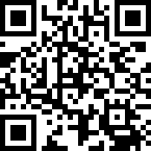
Please try offering online through Breeze, including the credit card option.
https://ecbckc.breezechms.com/give/online

Slide 4
【Announcements】

Slide 5
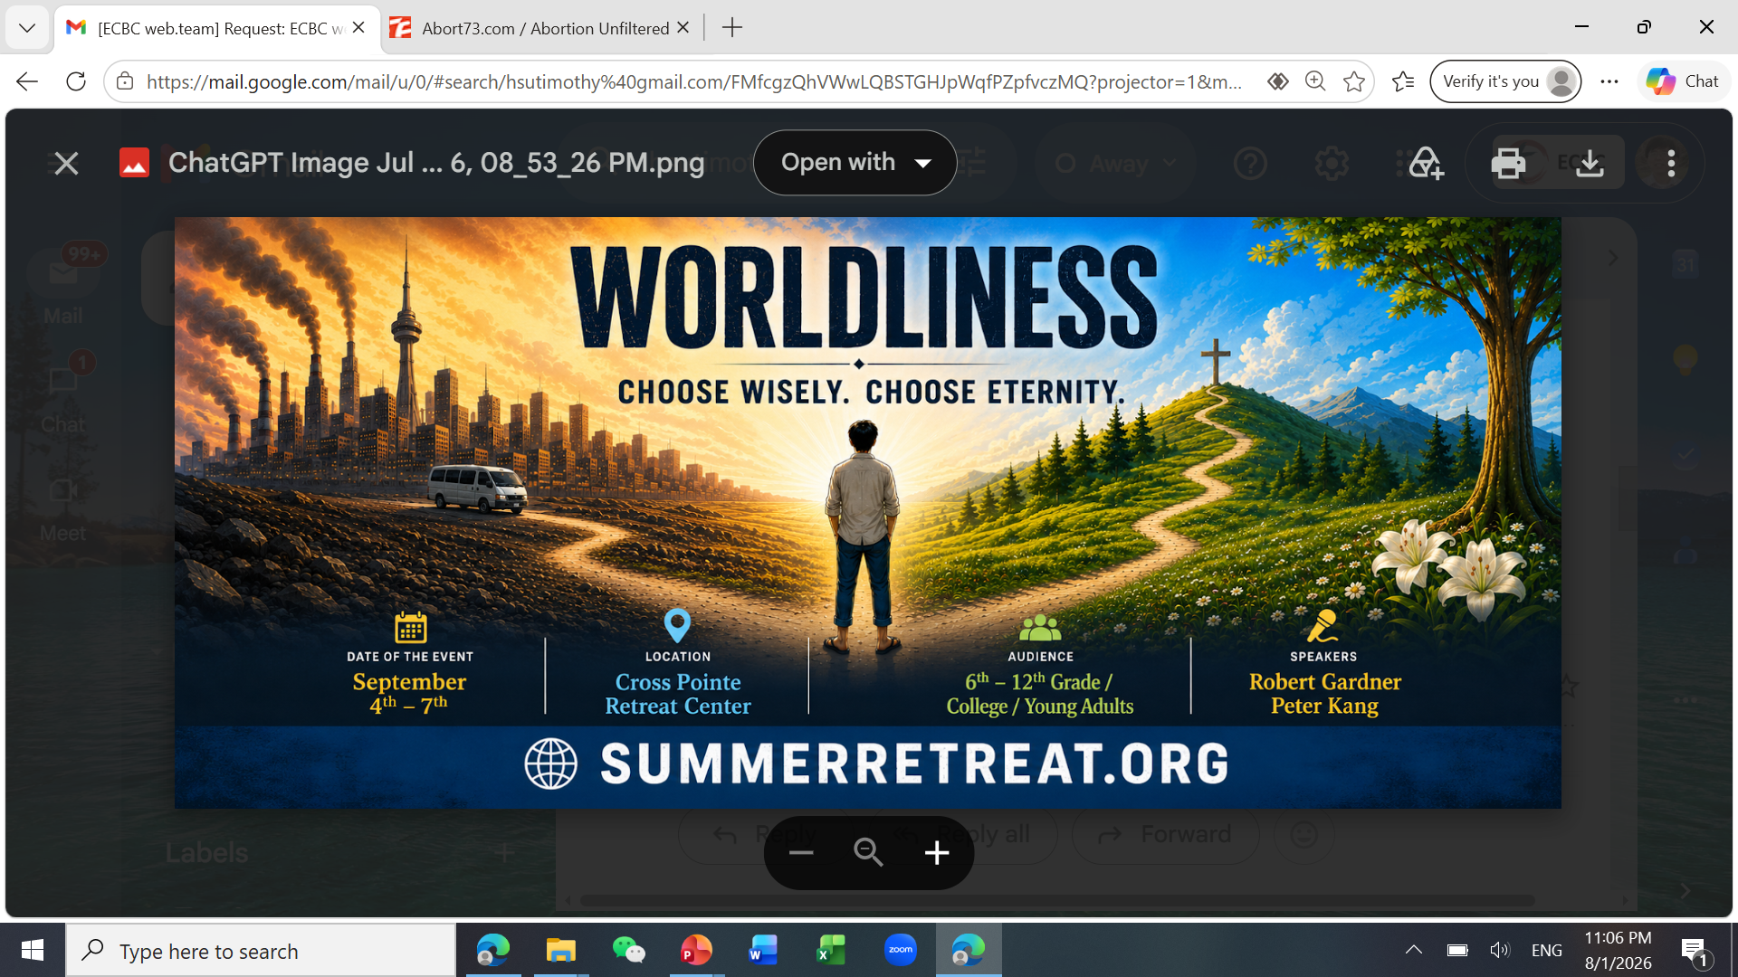

Slide 6
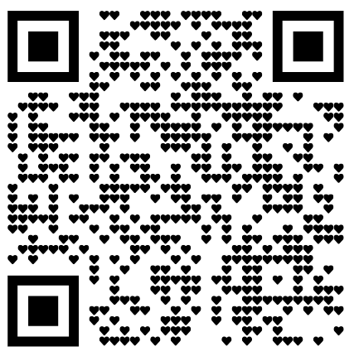
2026-2027 Coworker Service Survey
Please scan the QR Code →→
to show your service areas if you haven’t confirmed with any ministry leaders yet.

Slide 7
Please stay to attend the monthly prayer meeting today, 12:30-1:00 pm.

Slide 8
Evangelizing Muslims
by Missionary Melissa
Time: today, 1:00 PM
Location: Room 123
Lunch is provided

Slide 9
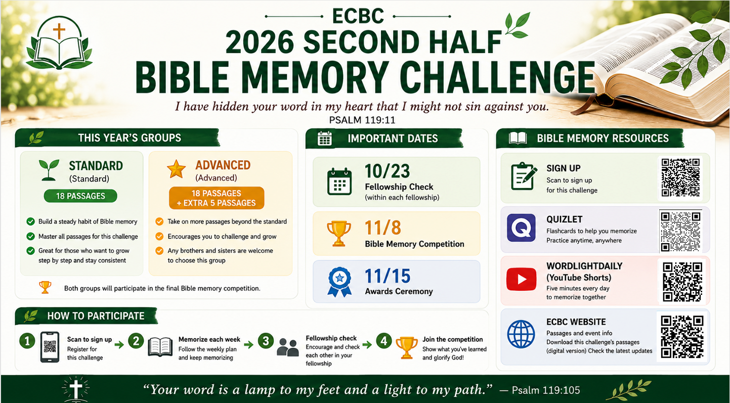

Slide 10


Slide 11
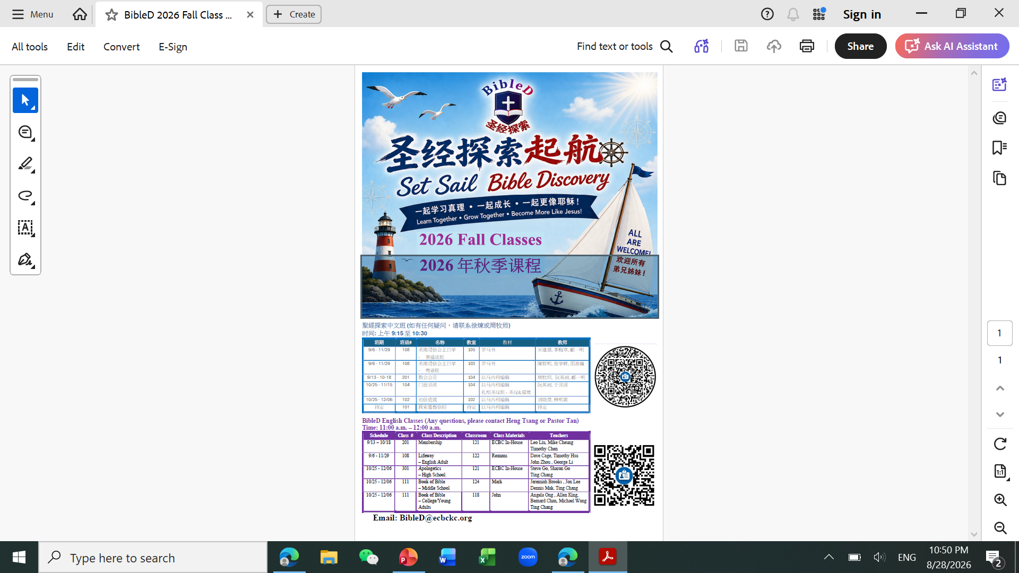

Slide 12
We’ll hold a membership meeting on September 13th, 1:30-3:30 pm. Please reserve your time for it.

