Slide 1

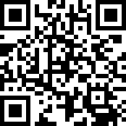
Please try offering online through Breeze.
https://ecbckc.breezechms.com/give/online

Slide 3
【Announcements】

Slide 4
Our August coworkers’ meeting will be held this Saturday (8/15) @8:30 am.

Slide 5
Our church's Chinese school will start at 1:30 pm this Saturday. Parents are welcome to register their children for Pinyin class to AP class.

Slide 6
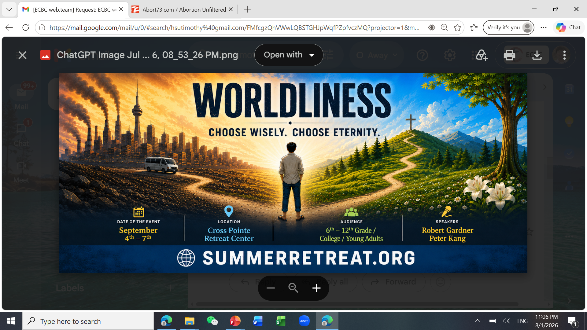

Slide 7
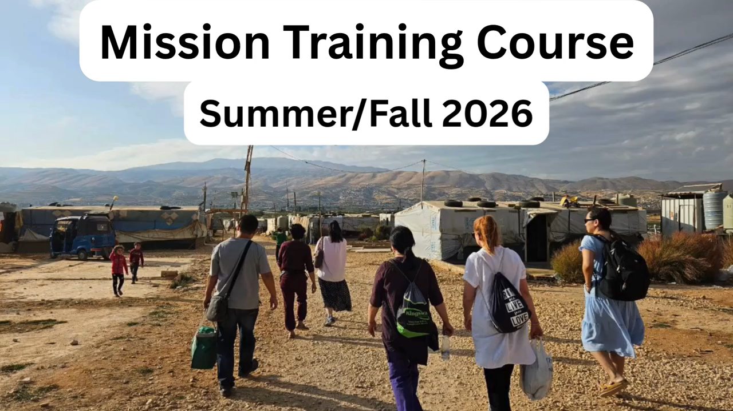

Slide 8

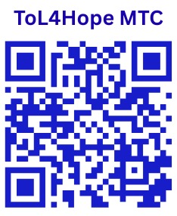
The Mission Training Course (MTC)
from August 15 through September 19, 2026
six Saturdays
1) For both medical and non-medical professionals
2) The registration site
ToL4hope.org/#registration-of-mtc
3) Registration fees
Adults: $60
Students: $40
3) In-person MTC classes in room 104 of ECBC
from 9 AM to noon CT, six Saturdays (8/15-9/19/2026)
4) The first in-person MTC class is open to the public.
You can join the first one without registration.
5) Questions: Ruth Sluder, ECBC
Notes:
This Mission Training Course (MTC) will help you be prepared and equipped to participate in the Great Commission.
Both medical and non-medical professions are welcome to join.
The in-person MTC classes will begin this Saturday, August 15, at 9 AM CT in room 104 of ECBC.
The first class is open to the public, so you can join the first one without registration!
If you have any questions, please contact sister Ruth Sluder!

Slide 9
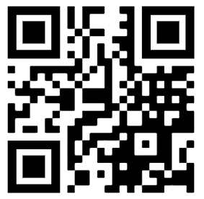
2026-2027 Coworker Service Survey
You don’t need to do it if you already confirmed with your committee leader.

Slide 10
Please stay to enjoy our monthly luncheon today.

Slide 11
