Slide 1

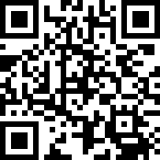
Breeze Online offering channel is OPEN
https://ecbckc.breezechms.com/give/online

Slide 3
【Announcements】

Slide 4
Our August coworkers’ meeting will be held on the 3rd Saturday (8/15) @8:30 am.

Slide 5
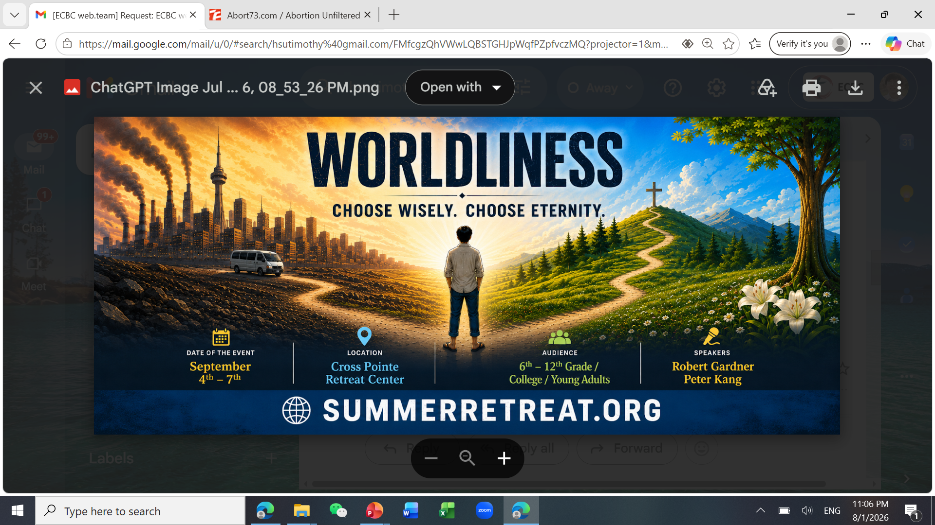

Slide 6
