Slide 1

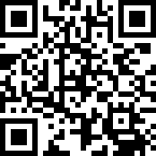
Please try offering online through Breeze, including with credit cards.
https://ecbckc.breezechms.com/give/online

Slide 3
【Announcements】

Slide 4
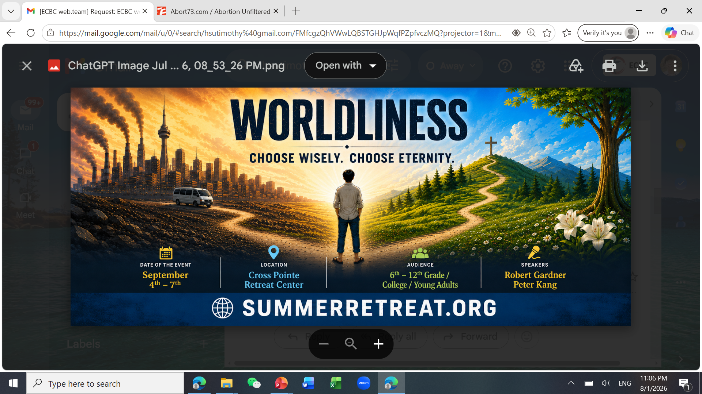

Slide 5
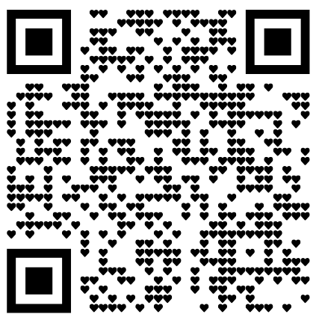
2026-2027 Coworker Service Survey
You don’t need to do it if you already confirmed with your committee leader.

Slide 6
Evangelizing Muslims
by Missionary Melissa
Time: 8/30, 1:00 PM
Location: Room 123
Light lunch provided

Slide 7
