Slide 1
【Announcements】

Slide 2
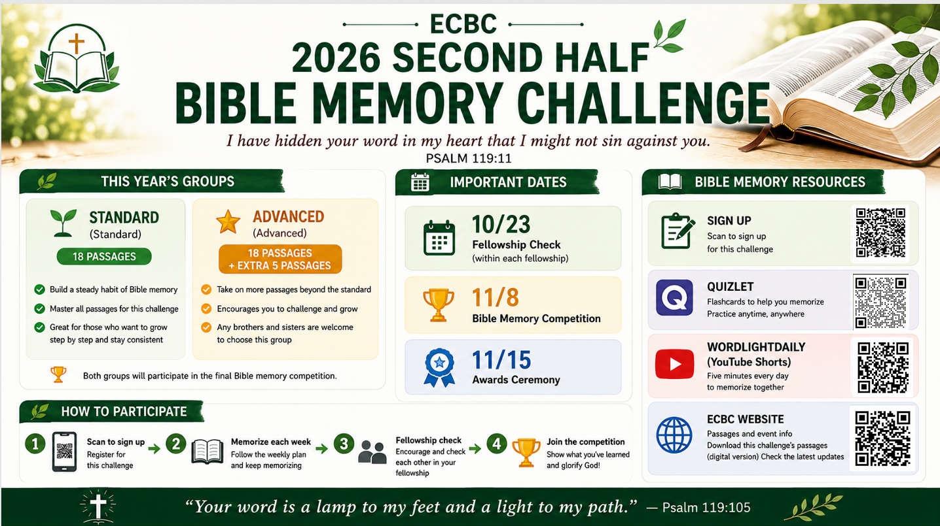

Slide 3
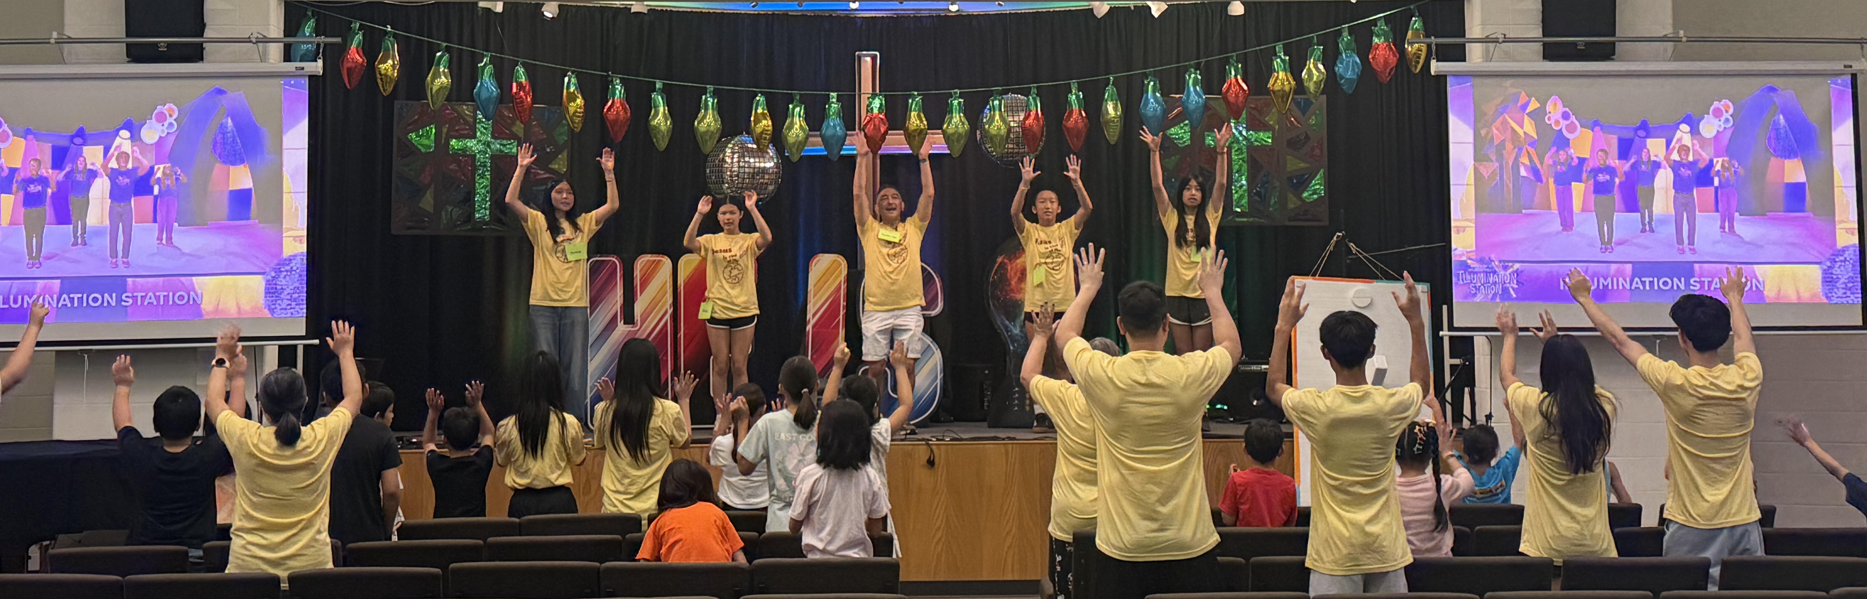
Our VBS concluded successfully last Friday. Next year, it will be held in the last week of July.。

Slide 4
We look forward to the YSMP’s sharing next Sunday (8/2).

Slide 5
If you have children who attend Children’s Sunday School, please check them in between 10:45 and 11 a.m. Late check-ins will cause interruptions in classrooms.

Slide 6


Slide 7
Please stay to attend today’s prayer meeting from 12:30 to 1:00 pm.

