Slide 1
【Announcements】

Slide 2
Please stay to attend the monthly prayer meeting today, 12:30-1:00 pm.

Slide 3
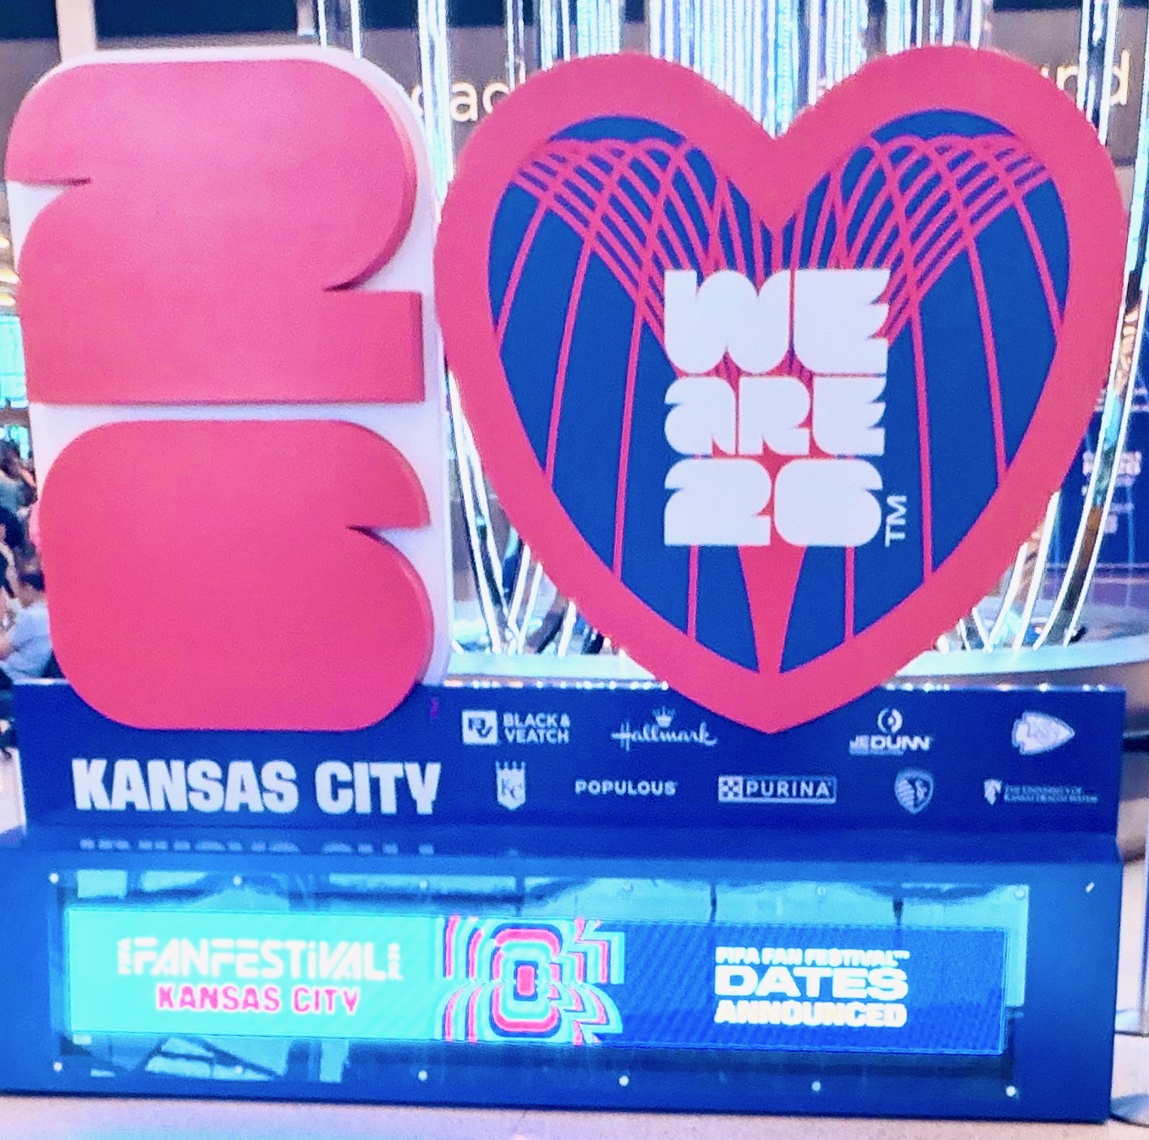

If you are willing to participate
World Cup KC gospel outreaches, please register with brother Eric Li. You will get a free special T-shirt.

Slide 4

We need 7 more brothers and sisters to help with our Baby Ministry on Sundays. Please contact Sister Sheen Xiao or Sister Julie Cashman if you can help.

