Slide 1
【Announcements】

Slide 2
Please stay to enjoy our monthly luncheon today.

Slide 3

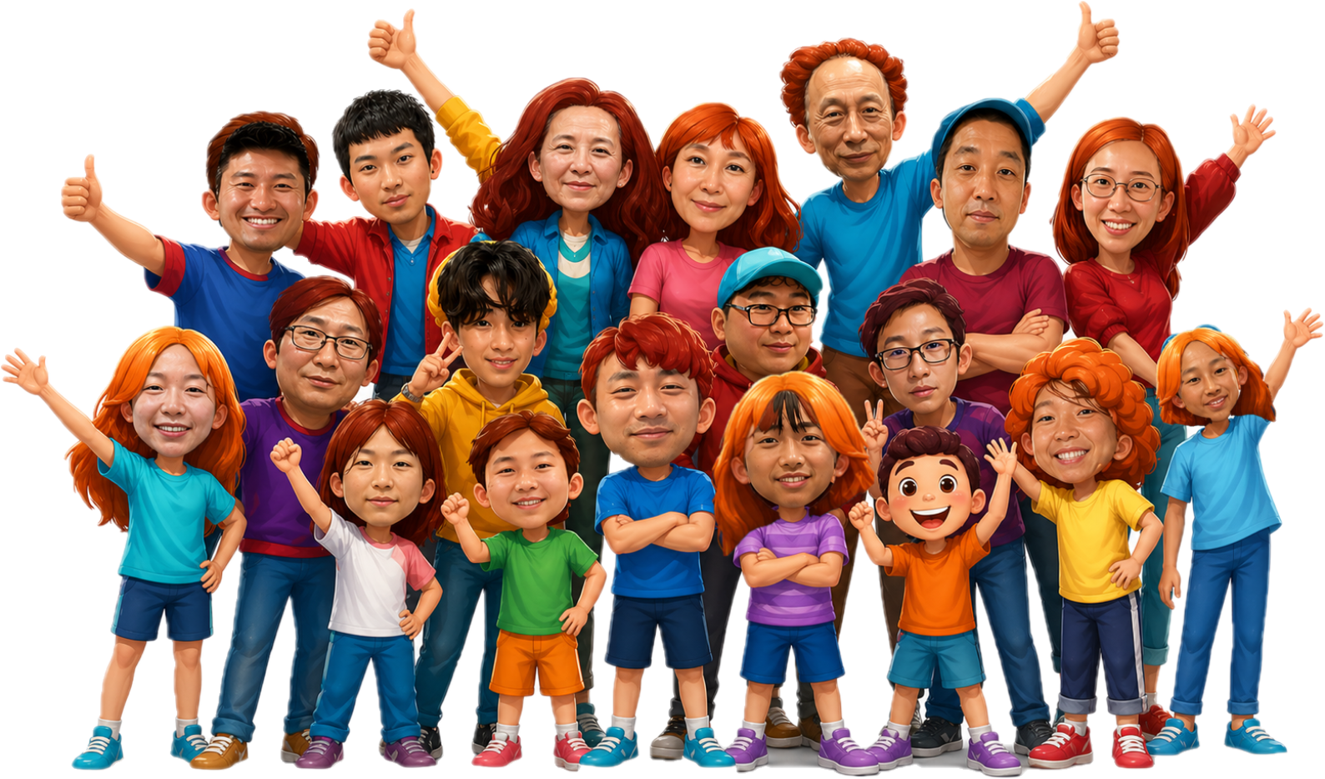
2026 YSMP Fundraising
青少年暑期宣教筹款
才艺表演
Fundraising Goal: $10K
?
6/14 ,Sunday
1:30-2:30 pm

Slide 4
All VBS volunteers need to attend the information meeting today at 12:30 p.m., in Rm 123.

Slide 5

We need 7 more brothers and sisters to help with our Baby Ministry on Sundays. Please contact Sister Sheen Xiao or Sister Julie Cashman if you can help.

