Slide 1
5/24 Business Meeting Approved
Nine New Members

Slide 2
Shirley Chen (陈如媛)
Iris Chou (史毓华)
James Leu (呂理山)
Li-Chin Leu (陳麗琴)
Trey Sluder
Ruth Sluder (霍锦）
Zoe Wang (王荣)
Lin Xu (徐琳)
WeiHua Zhang (张蔚华)

Slide 4
【Announcements】

Slide 5
Please stay to attend our monthly prayer meeting today 12:30-1:00 pm.

Slide 6
The Baby Ministry will provide baby care from 10:45 a to 12:15 p on Sundays starting this June. If you can help or are interested, please come to our first meeting in Room 123 at 12:30 p today. Any questions, please contact Sister Sheen Xiao or Sister Julie Cashman.

Slide 7

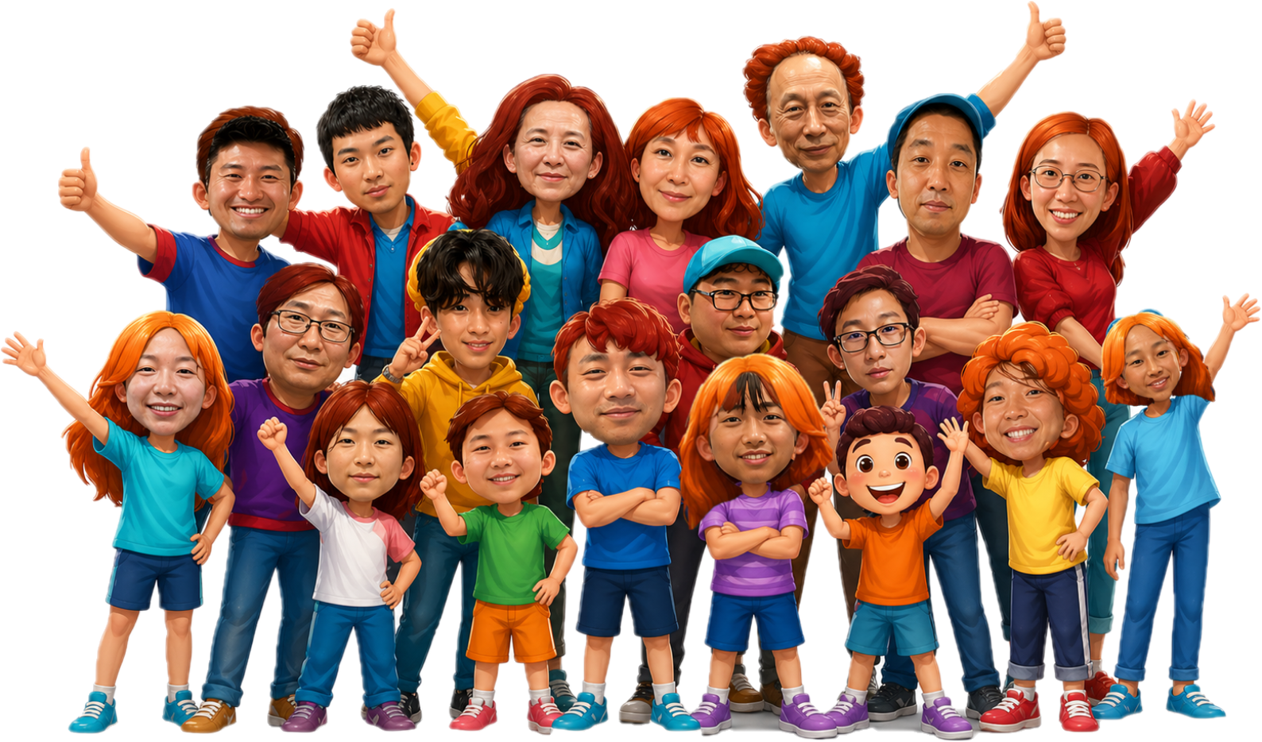
Performer sign-up deadline: June 7th
More info. Contact: Yao-Li
2026 YSMP Fundraising
青少年暑期宣教筹款
才艺表演
表演者报名截止日期：6月7日
联络人: 堯立
?
June 14th,2026
Sunday

