Slide 1
【Announcements】

Slide 2
All VBS volunteers please go to Room 123 for a 15-minute meeting at 12:30p today.

Slide 3
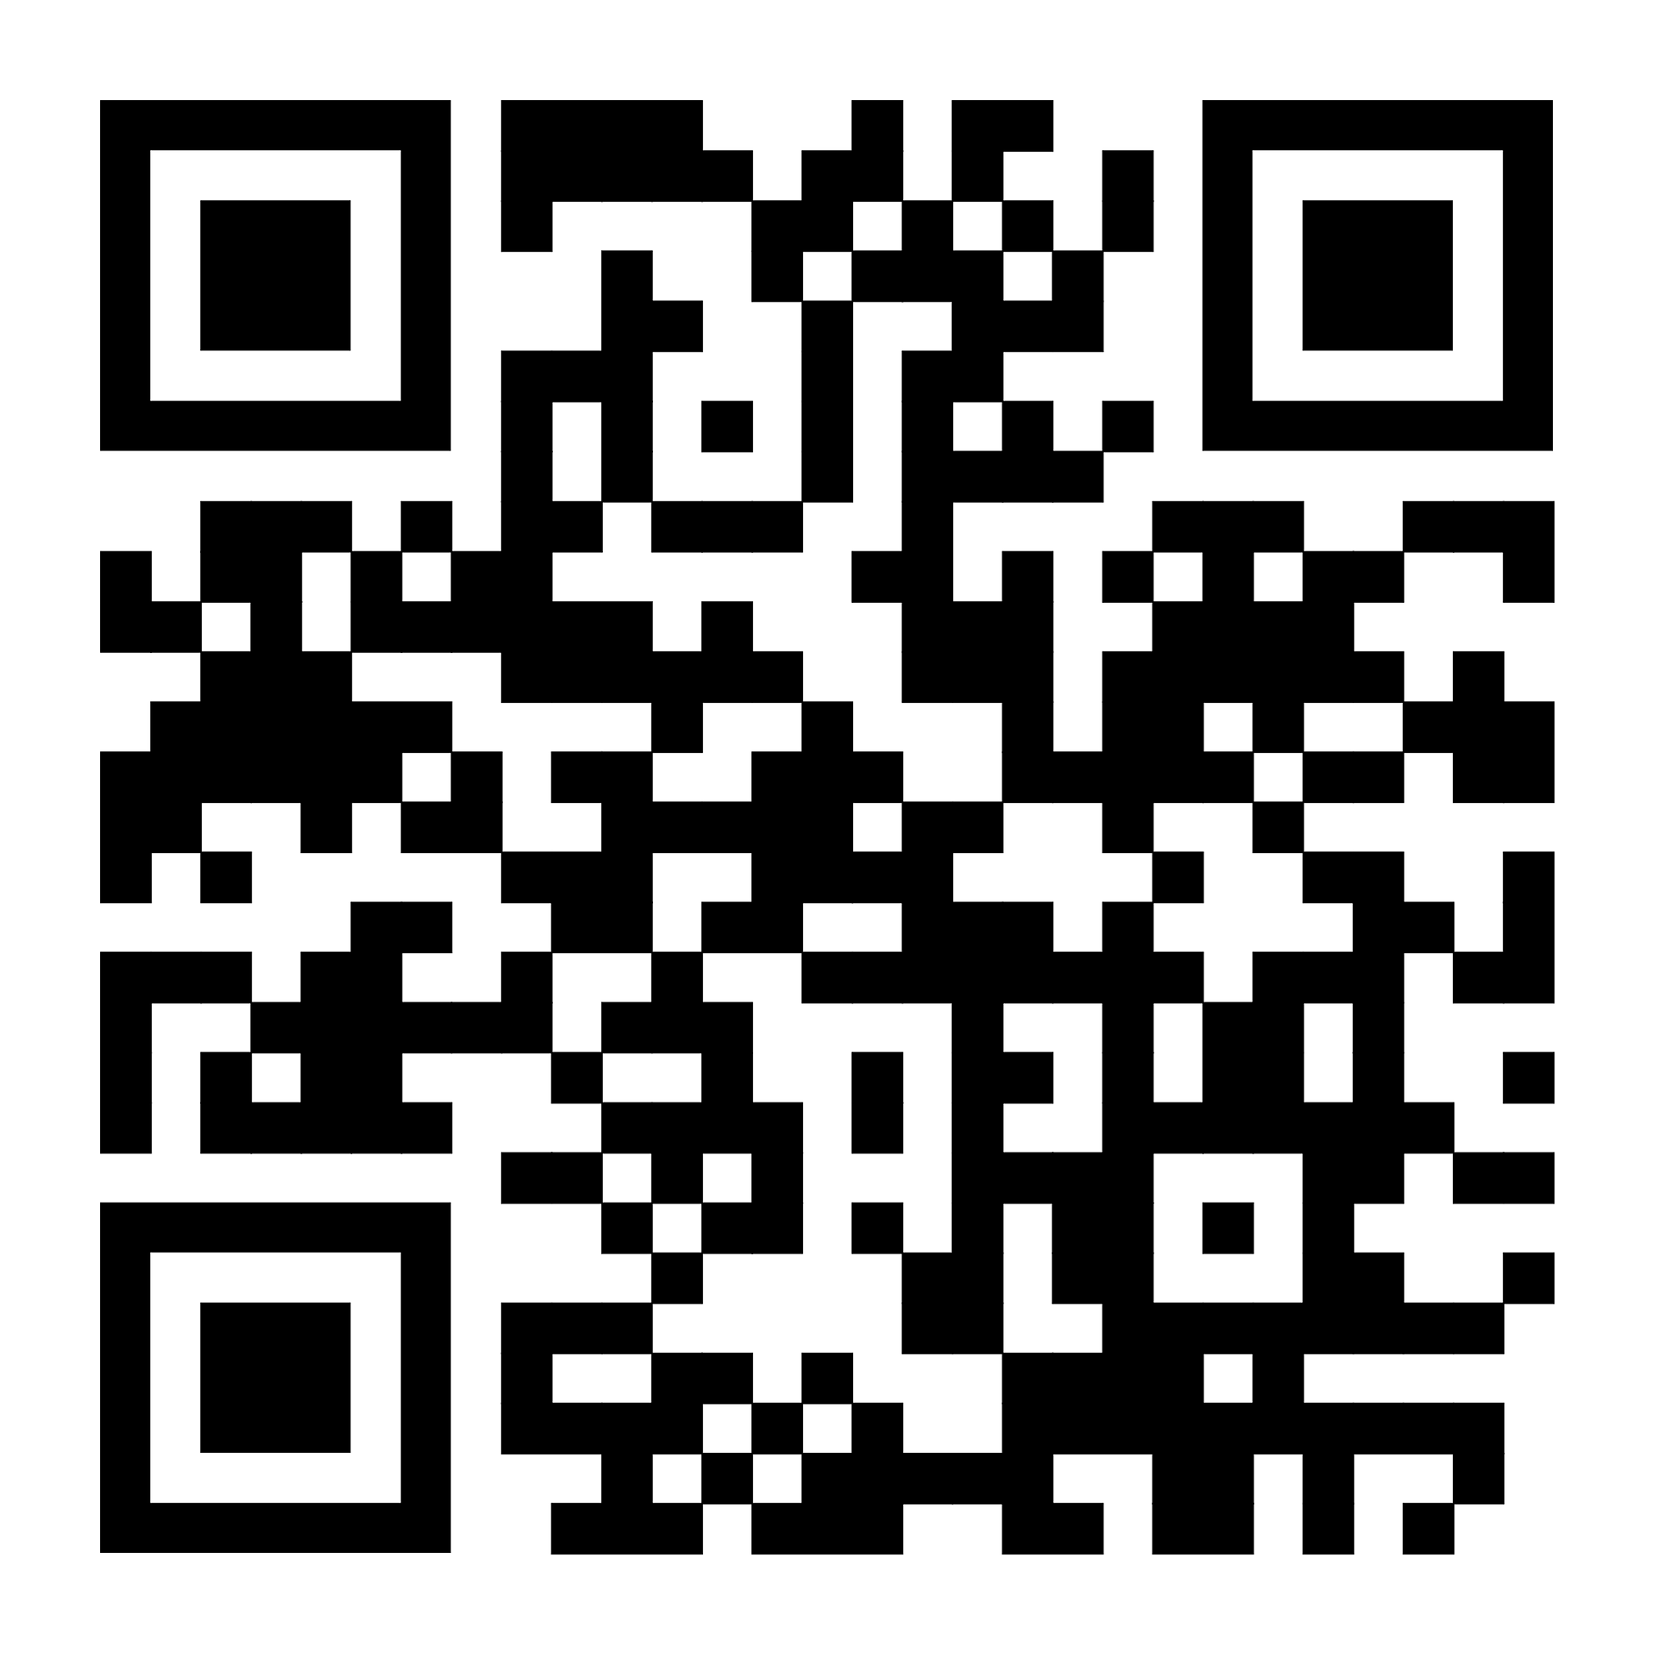
Elder Constitution/Bylaw Committee
Q & A Meeting in Room 101 TODAY @ 1 PM
  Attendees may buy your lunch boxes from YSMP fundraising.
  Online submission will get 1st priority followed by others.
  If you have questions after Q&A, please
  reach out to one of the following people:
    Steven Mak
    Dr. Steven Go
    Timothy Hsu
    Allen Wong
    Yi ming Li
    Mike Cheung
    Eric Li

Slide 4
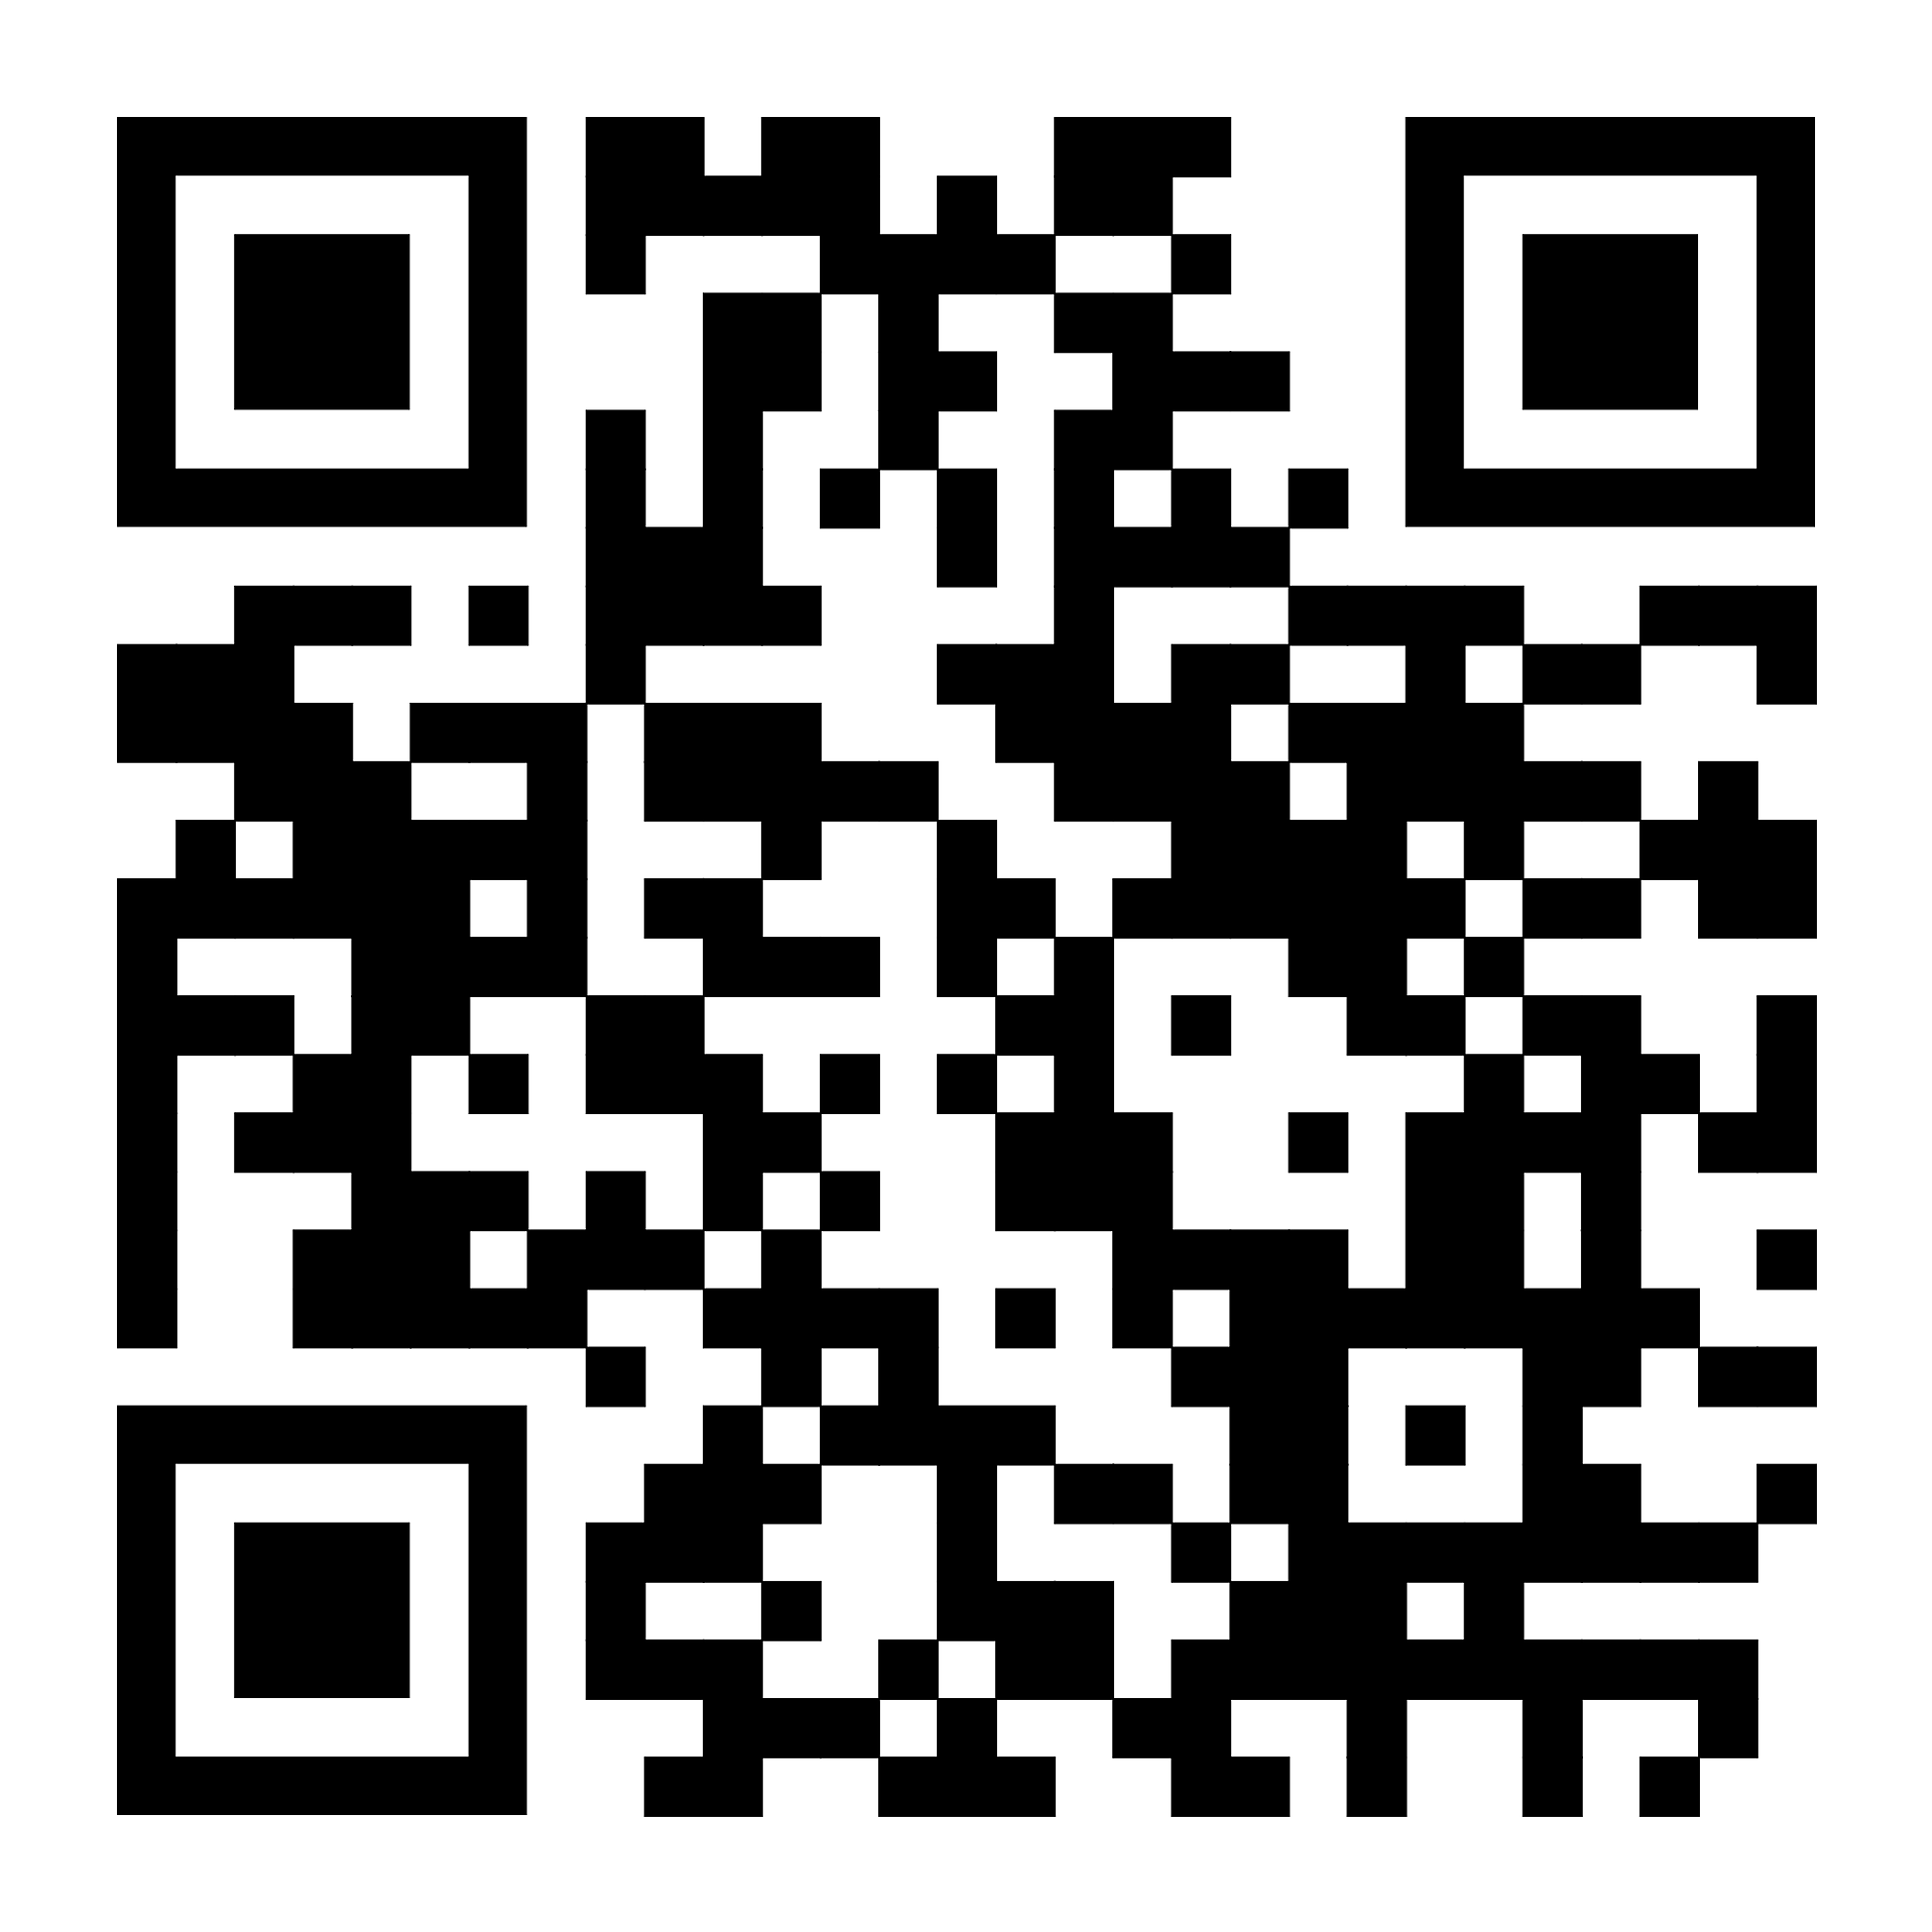
Elder Constitution-Bylaw Committee
Scan to read Constitution/Bylaw Amendment on Elders Drafts online and posted on the Church Bulletin boards.

Slide 5
Our may coworkers council meeting will be held this Saturday (5/9) @8:30。

Slide 6

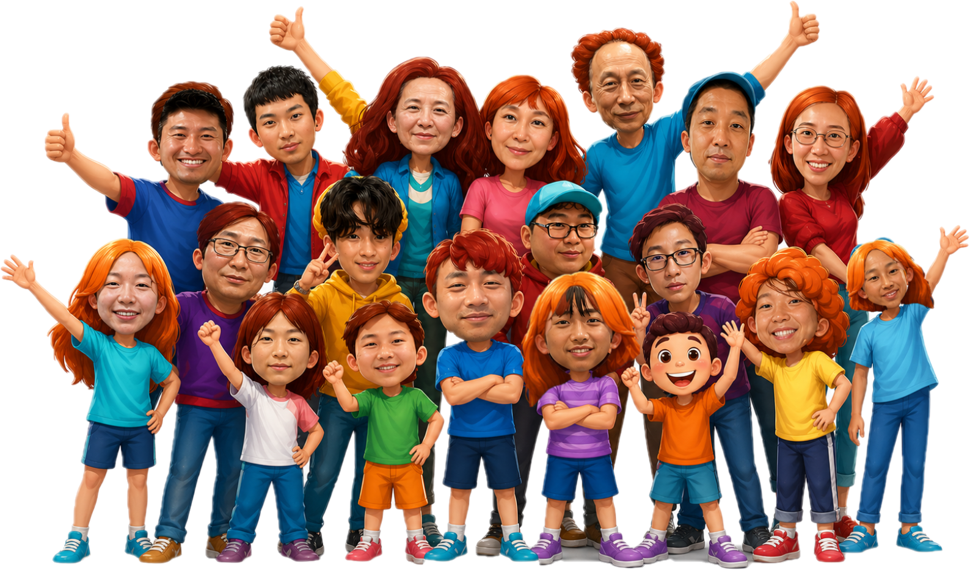
Performer sign-up deadline: June 7th
More info. Contact: Yao-Li
2026 YSMP Fundraising
青少年暑期宣教筹款
才艺表演
表演者报名截止日期：6月7日
联络人: 堯立
?
June 14th,2026
Sunday

Slide 7
The Baby Ministry will provide baby care from 10:45a to 12:15p on Sundays starting this June. If you can help or are interested, please come to our first meeting in room 123 at 12:30p next Sunday, May 10th. Any questions, please contact Sister Sheen Xiao or Sister Julie Cashman.

Slide 8
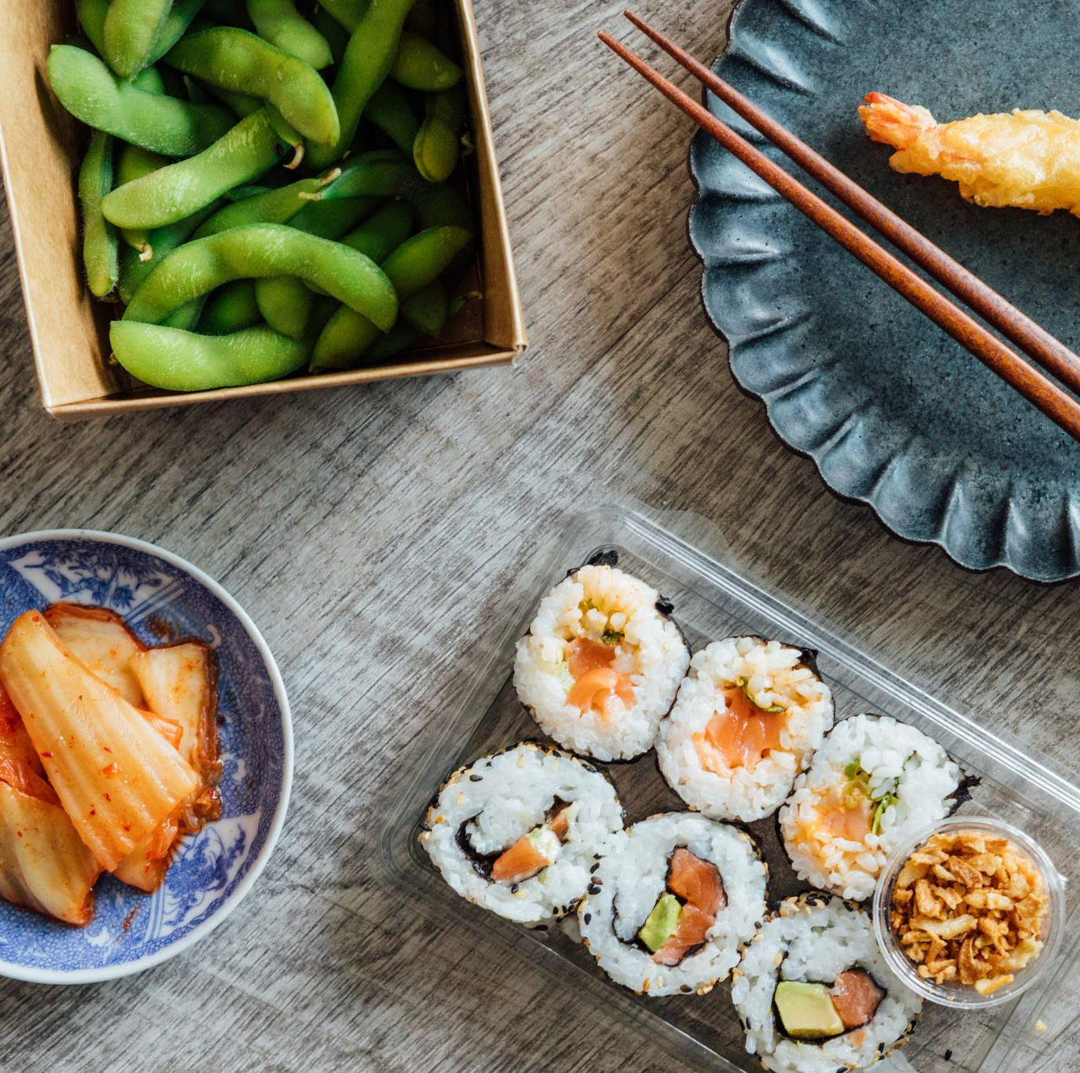
The monthly luncheon for May will be changed to May 24 when we have the membership meeting。

