Slide 1
【Announcements】

Slide 2

Please stay to enjoy our luncheon today. The members’ business meeting follows from 2-4 pm.

Slide 3
The agenda for today’s members’ business meeting has been posted on the bulletin board. Please check it out.

Slide 4
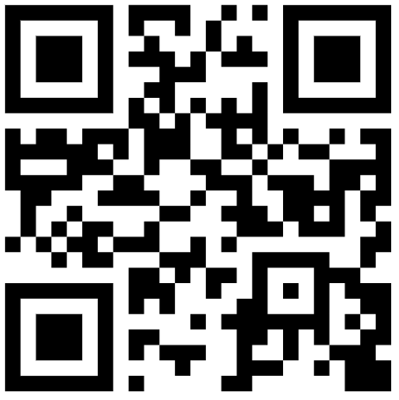
Elder Constitution-Bylaw Committee
Please scan to read Constitution/Bylaw Amendment on Elders online and posted on the Church Bulletin boards.

Slide 5
The testimonies of the candidates being recommended for church membership today have been posted on the bulletin boards. Everyone is encouraged to read and learn about them, and members will be asked to vote at the business meeting this afternoon.

Slide 6

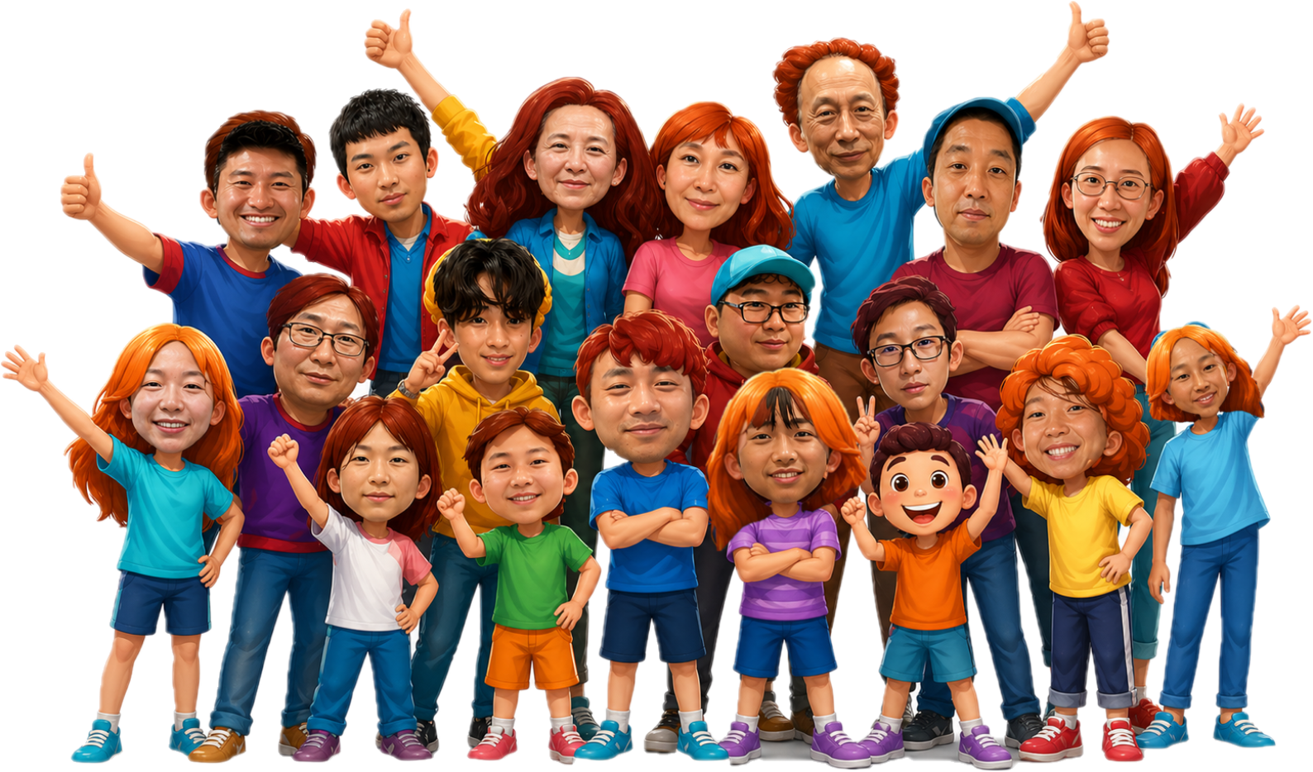
Performer sign-up deadline: June 7th
More info. Contact: Yao-Li
2026 YSMP Fundraising
青少年暑期宣教筹款
才艺表演
表演者报名截止日期：6月7日
联络人: 堯立
?
June 14th,2026
Sunday

Slide 7
The Baby Ministry will provide baby care from 10:45a to 12:15p on Sundays starting this June. If you can help or are interested, please come to our first meeting in Room 123 at 12:30p on May 31st. Any questions, please contact Sister Sheen Xiao or Sister Julie Cashman.

