Slide 1
Annie Armstrong Easter Offering for North American Missions
In April, we will continuously collect this special offering to be used 100% to support North American missionaries. This year's theme is: “More Than a Gift." Our church's goal is $6,000. Please write your check to ECBC and memo “NA Missions”. May God move everyone to give generously and spread the gospel throughout North America together!

Slide 3
【Announcements】

Slide 4
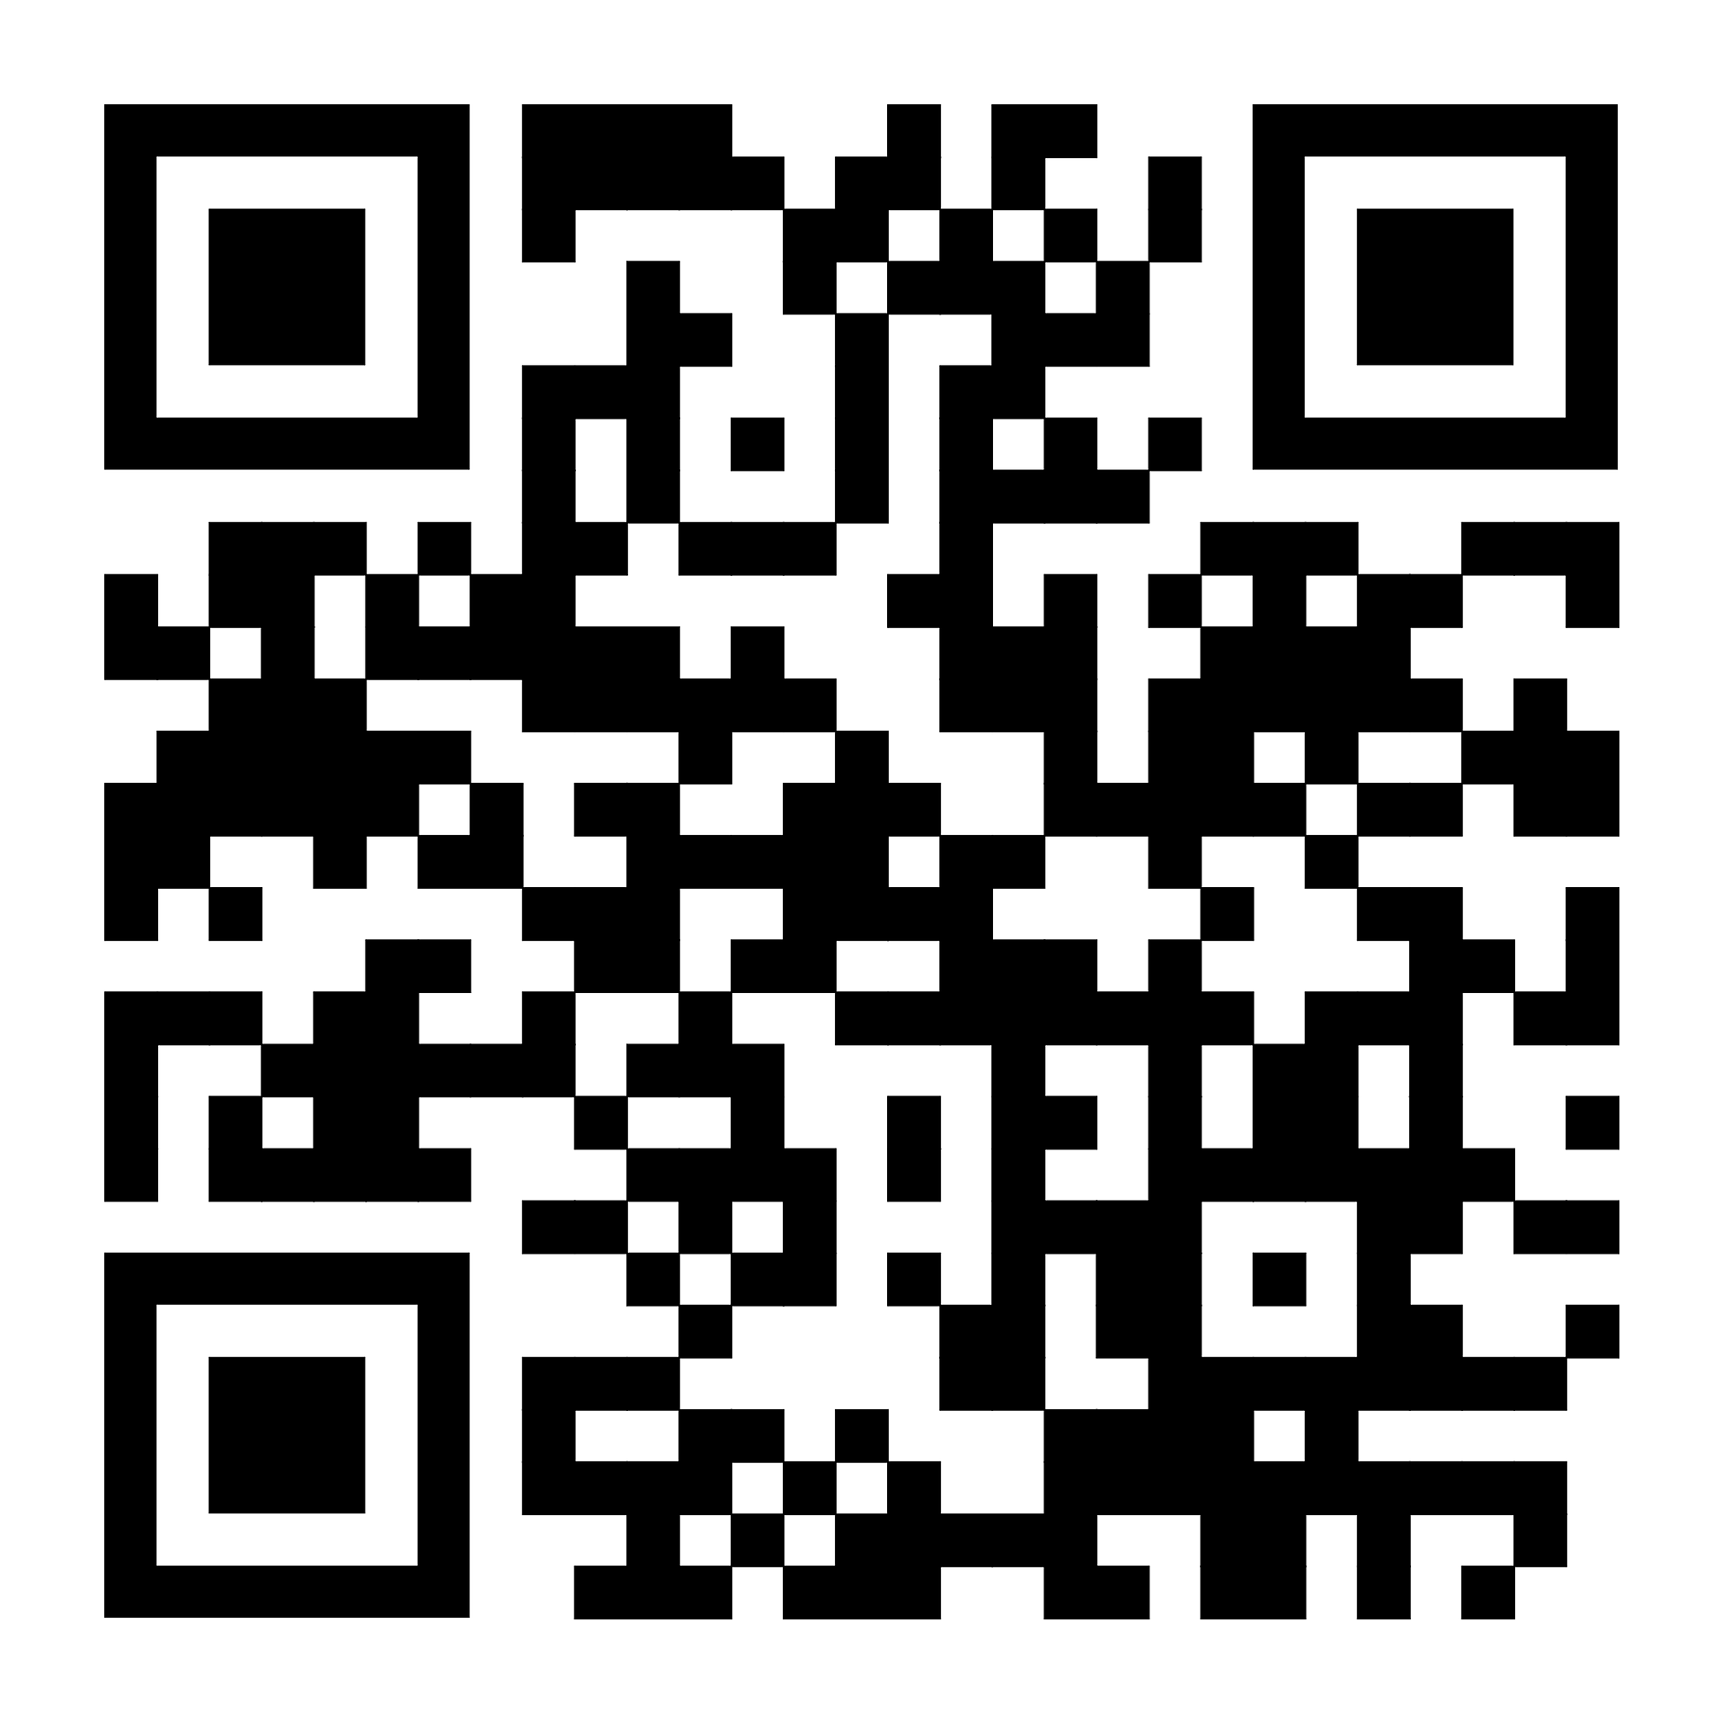
Elder Constitution/Bylaw Committee
Q & A Meeting on May 3rd in Room 101 @ 1 PM
Please submit questions online ahead of time.
Online submission will get 1st priority followed by others.
If you have questions after Q&A, please
reach out to one of the following people:
Steven Mak
Dr. Steven Go
Timothy Hsu
Allen Wong
Yi ming Li
Eric Li

Slide 5
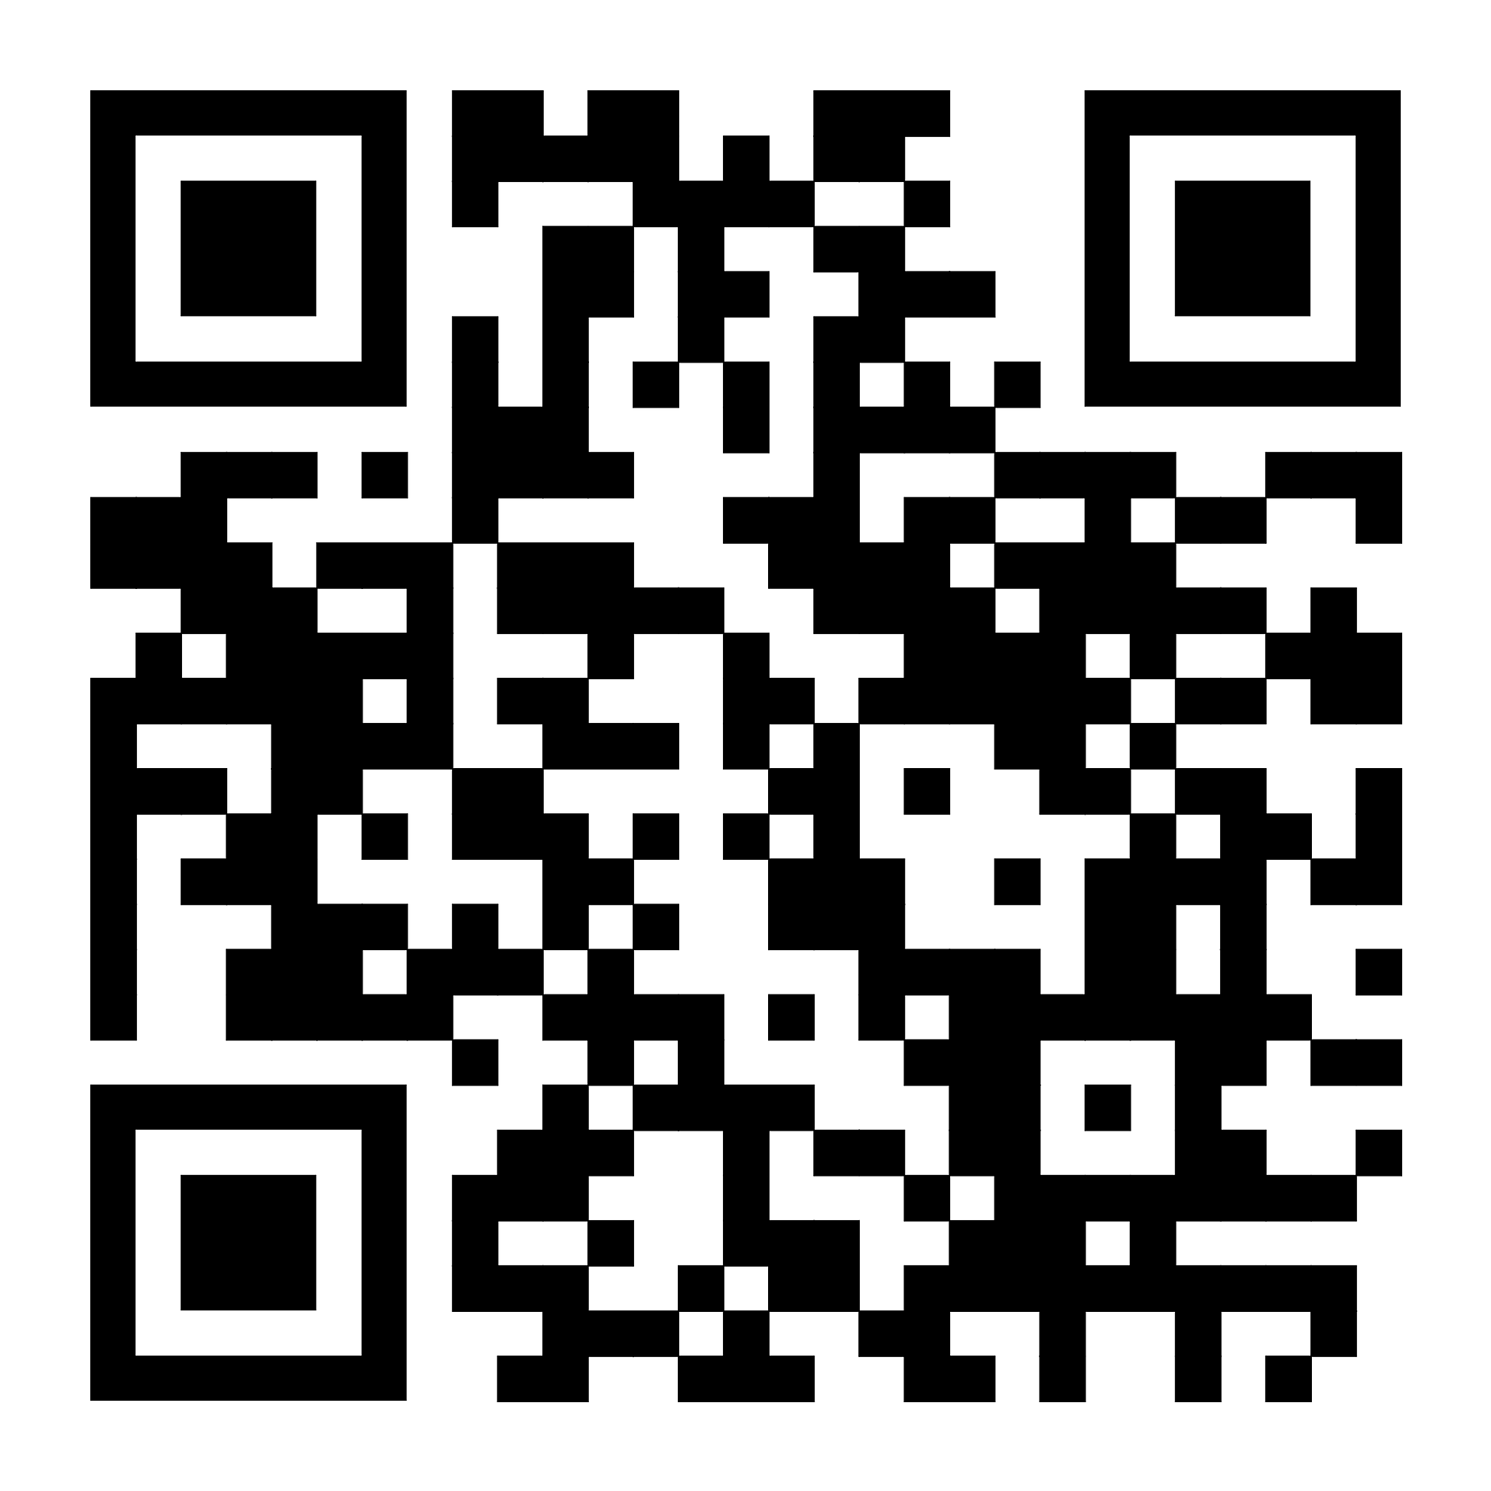
Elder Constitution-Bylaw Committee
Scan to read Constitution/Bylaw Amendment on Elders Drafts online and posted on the Church Bulletin boards.

Slide 6

18 brothers and sisters have been approved to go for the 2026 YSMP (7/10-17). Please pray for their mission trip and support them in reaching their $8,000 fundraising goal. They will have a series of fundraising activities soon.

Slide 7
We need brothers and sisters to help in baby care ministry from 10:45a to 12:15p on Sunday starting this June. Please sign up on the form if you can help. The form is outside of the office.

