Slide 1
Please play Annie Armstrong video and announcement before regular offering time.

Slide 2
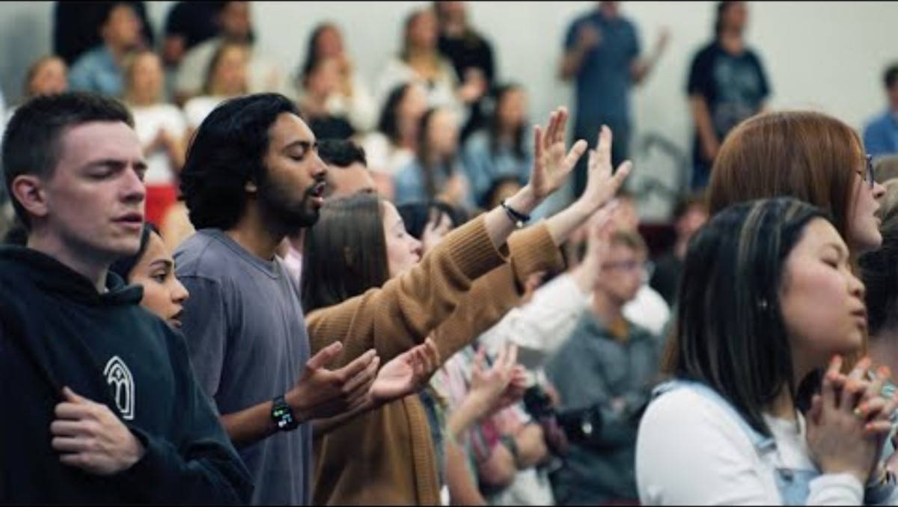

Slide 3
安妮莊复活节北美宣教奉献 Annie Armstrong Easter Offering for North American Missions
四月份我门收集这项十一奉献之外的特别宣教奉献，100%用来支持在北美的宣教士。今年的主题是：“成就大事！” 我们教会的目标是$6,000。支票请写给给ECBC并备注“北美宣教”。求神感动大家慷慨奉献，共同将福音传遍北美！In April, we will collect this special offering to be used 100% to support North American missionaries. This year's theme is: “More Than a Gift." Our church's goal is $6,000. Please write your check to ECBC and memo “NA Missions”. May God move everyone to give generously and spread the gospel throughout North America together!

Slide 5
【Announcements】

Slide 6



Please stay to enjoy our luncheon today.

Slide 7

2026青少年暑期短宣将于7月10-17日举行。欢迎受浸基督徒且是教会会员的七年级及以上学生的，包括大学生和成人会员申请。申请表请联系Sharon或Yaoli姊妹。今天是申请截止日。
2026 YSMP) will take place from July 10 to July 17. To apply, you must be in 7th grade or above, a baptized Christian, and a church member. Please see Sister Sharon or Yaoli for an application. Applications will be due on April 5. College students and adult members are welcome to apply.

Slide 8
Our 2026 VBS first meeting is at 12:30pm today. Please grab a lunch from the cafeteria and come join our meeting in classroom 123 if you can help or are interested in helping.

Slide 9
We need brothers and sisters to help in baby care ministry from 10:45a to 12:15p on Sunday starting this June. Please sign up on the form if you can help. The form is outside of the office.

