Slide 1

【Announcements】

Slide 2
2025 offering receipts have been emailed to all givers on 1/16/2026. The email was sent by finance@ecbckc.Org Please let the finance department know if you find any errors or didn’t receive your email.

Slide 3
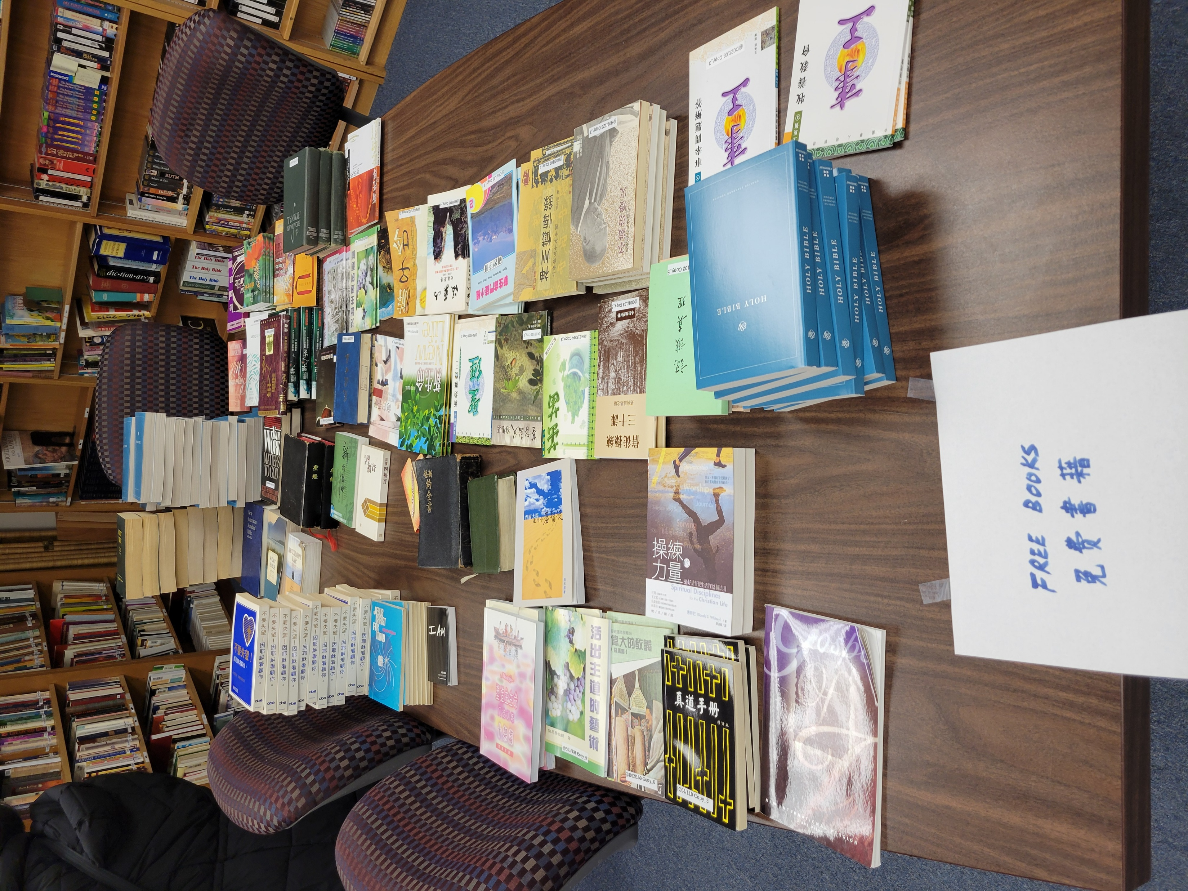
Library Announcement In order to clear out shelf space, the library is giving out books that we have too many copies. Please stop by the library after worship to pick up your free books.

Slide 4
Next Sunday (2/8), we will still have a monthly luncheon as usual. On the third Sunday (2/15), we will have a special lunch to celebrate the Chinese New Year together!

Slide 5
ECBC Business Meeting will be held on February 8th at 2pm. One of the discussion items is to amend ECBC constitution article 6 (Church Officers) as follows:
The church officers shall consist of the pastor(s), staff, elders, deacons, and other officers as the church may determine necessary for carrying out the purpose of the church.

Slide 6

Please note our February’s Coworkers Council Meeting will be held at 8:30 am on the first Saturday (2/7).

Slide 7
All brothers and sisters who serve at our Children’s Ministry, please attend a Recharge Meeting at 12:30 pm today in Rm 123.

