Slide 1

【Announcements】

Slide 2
Praise the Lord! We received a total of $31,740.33 (16,740.33+15K) for the Lottie Moon International Missions special offering. May God greatly bless all brothers and sisters with their generous offerings. And may the gospel be preached to the ends of the earth through faithful IMB missionaries.

Slide 3


The January 2026 Coworkers Council Meeting will be held at 8:30 a.m. this Saturday (1/10) in Rm 103. All coworker representatives are invited to participate. ，

Slide 4
Next Sunday (1/11), we’ll have a free monthly luncheon.

Slide 5
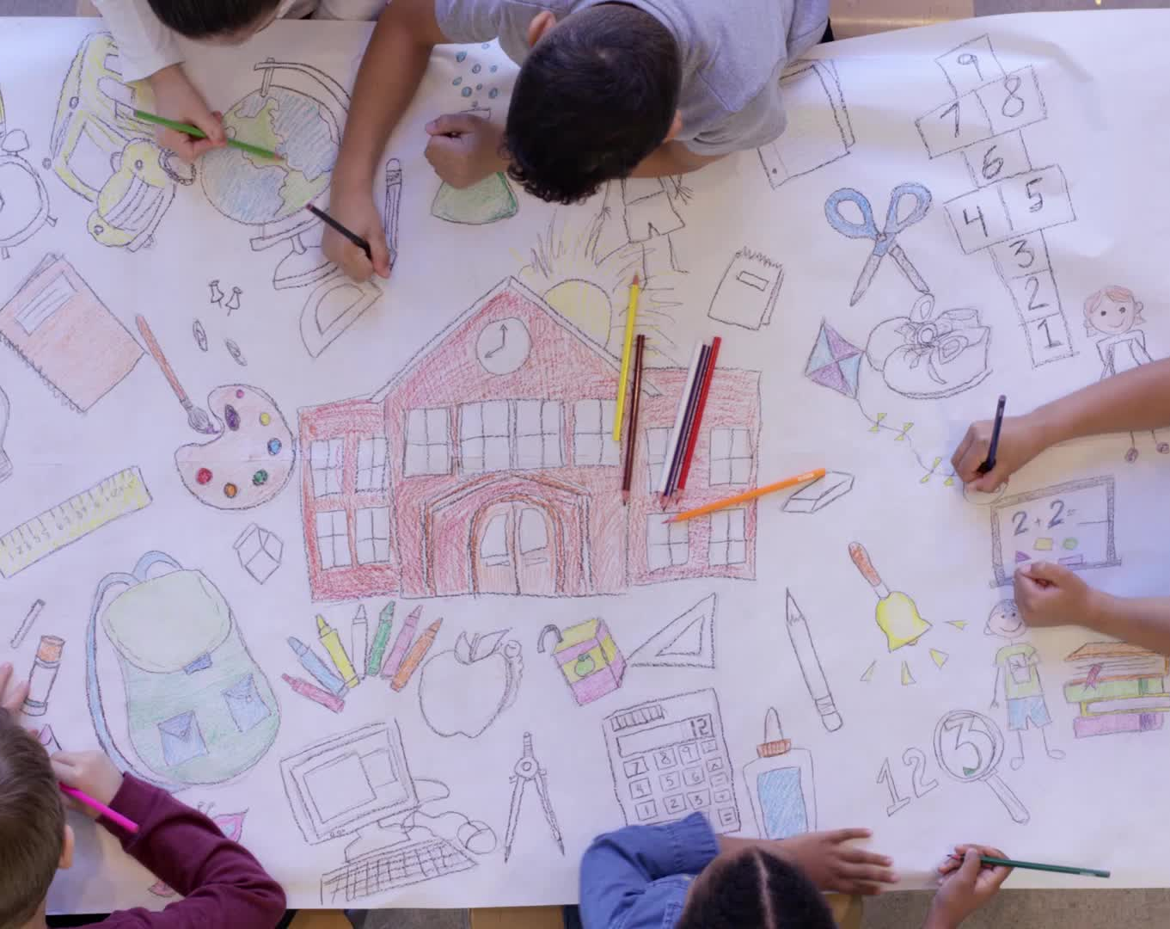
The spring semester of Emmanuel Chinese School starts this Saturday, 1/10.

Slide 6
ECBC Business Meeting will be held on February 8th at 2pm. One of the discussion items is to amend ECBC constitution article 6 (Church Officers) as follows:
The church officers shall consist of the pastor(s), staff, elders, deacons, and other officers as the church may determine necessary for carrying out the purpose of the church.

