Slide 1

【Announcements】

Slide 2
We will be having a newcomers’ luncheon today at 12:30 pm in Rm 123.

Slide 3
2025 offering receipts have been emailed to all givers on 1/16/2026. The email was sent by finance@ecbckc.Org
Please let the finance department know if you find any errors or didn’t receive your email.

Slide 4
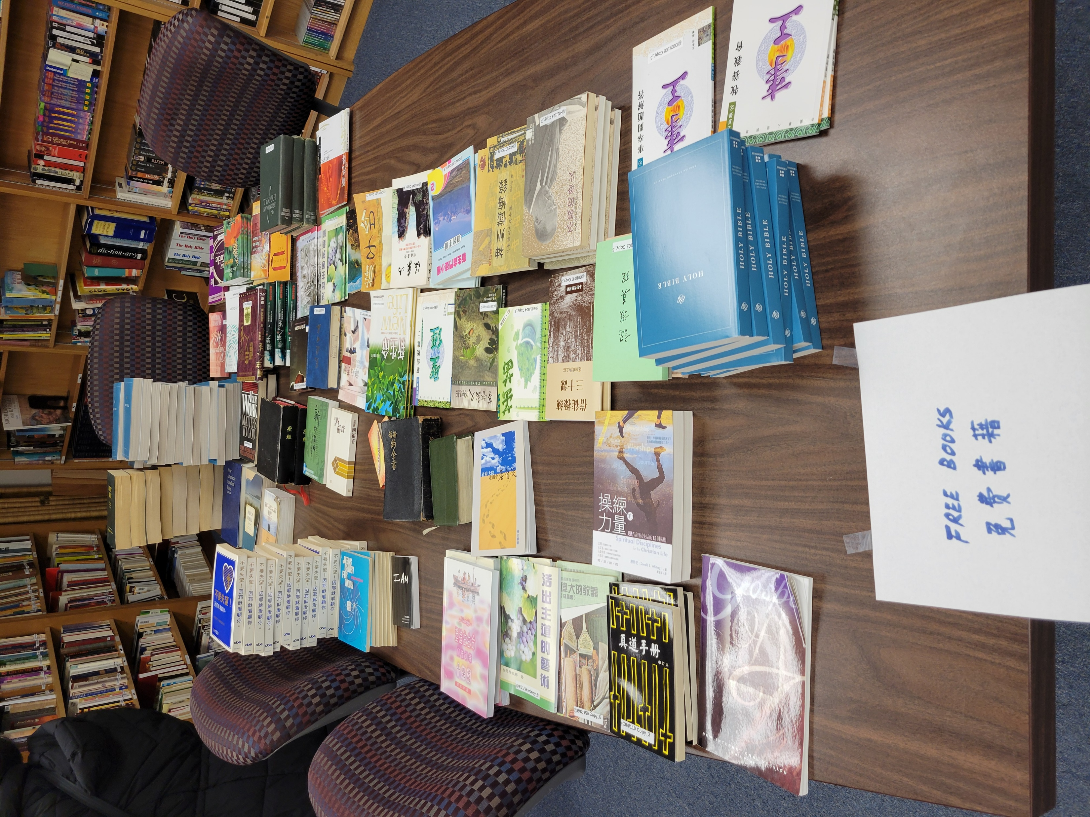
Library Announcement
In order to clear out shelf space, the library is giving out books that we have too many copies. Please stop by the library after worship to pick up your free books.

Slide 5
Our ECBC Chinese School invited tax expert Sister Kathie Shen to host a Q&A session on tax filing. Everyone is welcome to attend.
Date: January 24th, Saturday
Time: 1:40 pm
Location: Room 101

Slide 6
ECBC Business Meeting will be held on February 8th at 2pm. One of the discussion items is to amend ECBC constitution article 6 (Church Officers) as follows:
The church officers shall consist of the pastor(s), staff, elders, deacons, and other officers as the church may determine necessary for carrying out the purpose of the church.

