Slide 1
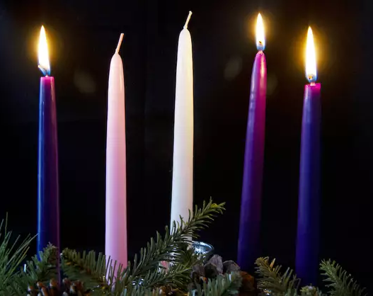
（Roy & Jade）
Advent Candle
（John 3:16） “For God so loved the world, that he gave his only Son, that whoever believes in him should not perish but have eternal life.”
Love

Slide 3
2026 Budget Congregational Vote

Slide 4
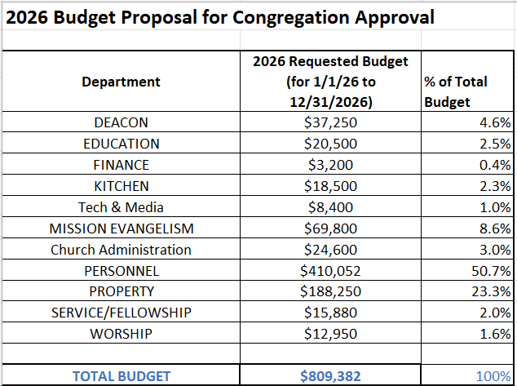

Slide 5
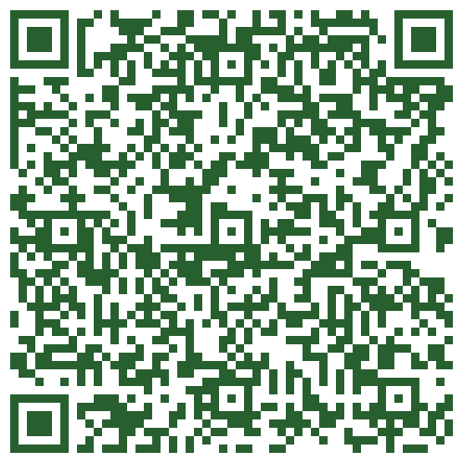
Members can vote with the QR code→ or a paper ballot

Slide 6
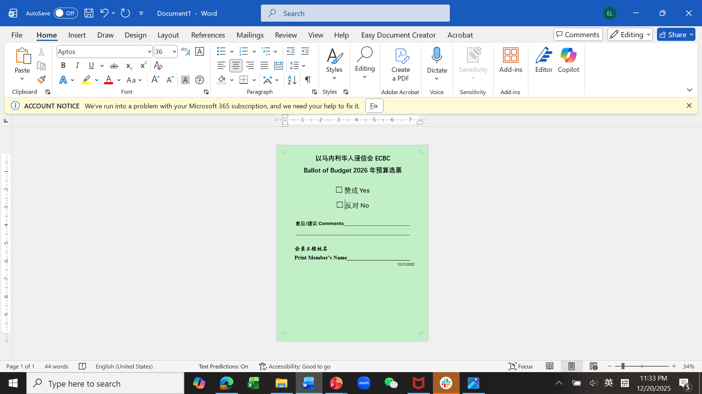

Slide 8
【Lottie Moon International Missions Offering】
We continue to collect this special offering till the end of this month to support IMB missionaries all over the world. The country’s goal is $210 million; our church’s is $12,000. May God touch everyone’s heart to give generously so that we can achieve our goal. Please write your check to ECBC and memo Lottie Moon. For cash offering, you may use the special envelopes.

Slide 10

Announcements

Slide 11
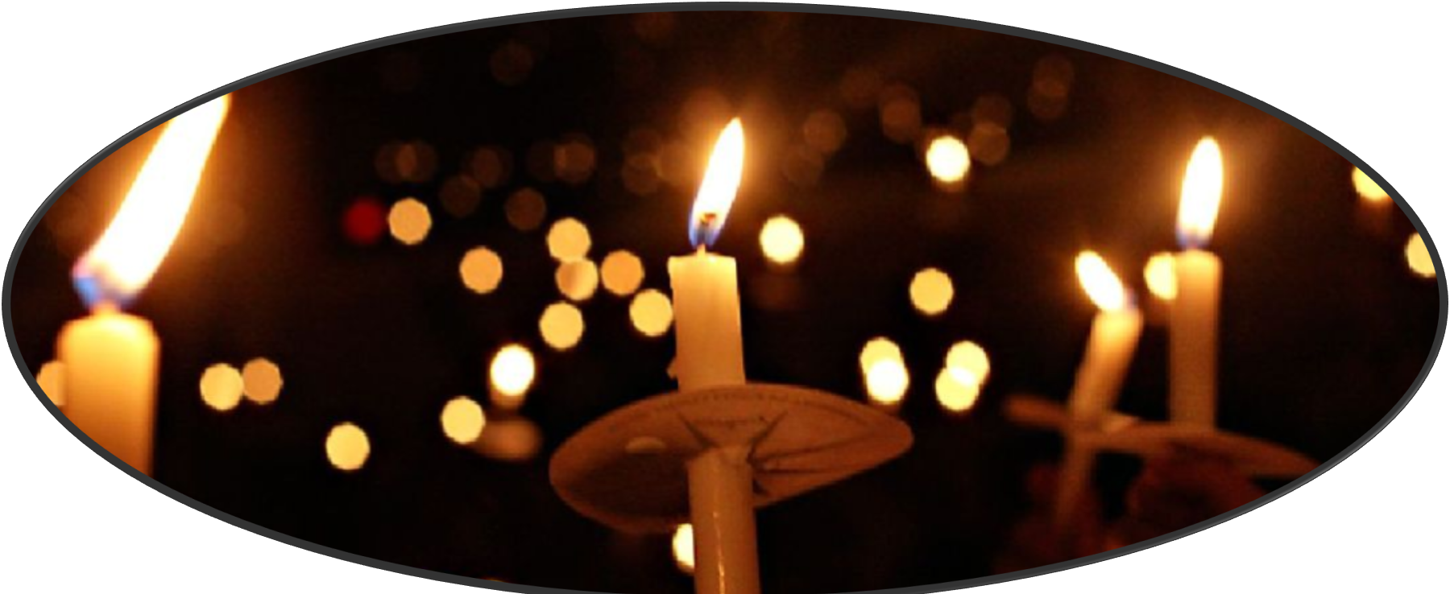
Christmas Eve Candlelight Worship & Baptism: 12/24 @7:30pm.

Slide 12
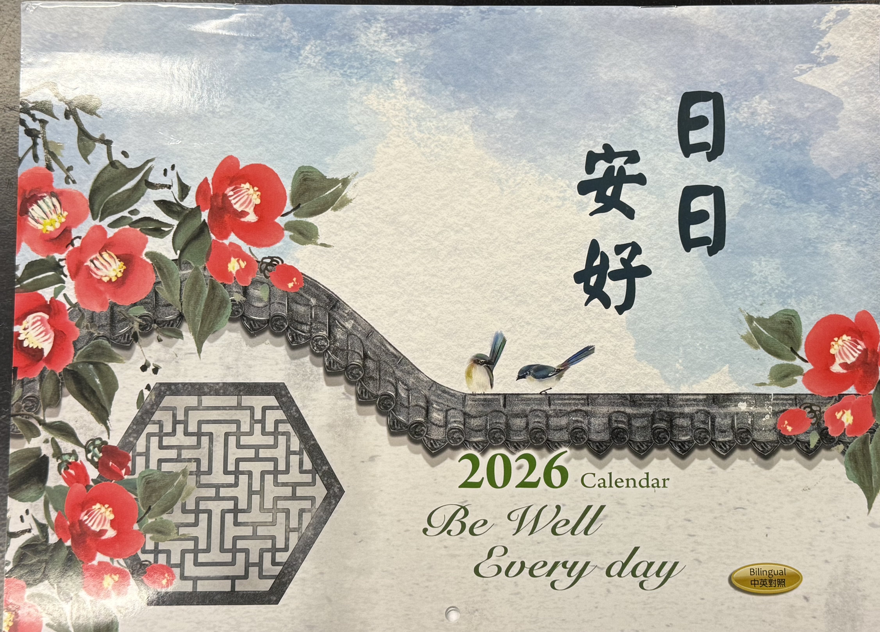
2026 Church Calendar
Please Take One
at the Front Office
if you haven’t.

