Slide 1

【Announcements】

Slide 2
2025 Elder-in-Training Candidates Announcement
The candidates for Elder in Training are nominated by the pastor team and interviewed by church members.
On December 28, 2025, members will vote to approve the candidates (75% approval required). Approved candidates will work alongside pastors for one year before being confirmed as elders.
Full questionnaire responses are posted on the hallway board.
Printed copies are available in the church office.
Digital copy available here:
https://drive.google.com/file/d/1v1jCPQ-pGshWbYg1TFzHPr0u53JTJ1Y3/view?usp=sharing

Slide 3
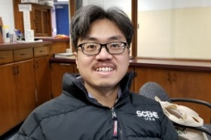
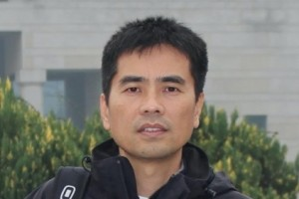
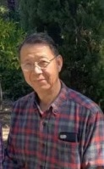
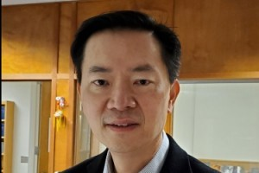
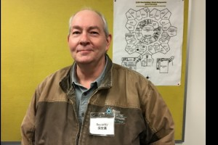
Candidates 候选人

Slide 4
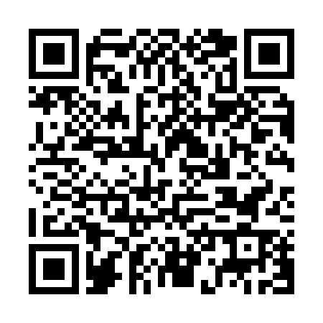
Candidate Q&A Sessions
11/23/2025 (Sun)
David Cage 凯·大卫 | Mike Cheung 张学辉
2 PM – 4 PM | Worship Hall
11/30/2025 (Sun)
Yiming Li 郦一明 | Jonathon Lee 李寿富
2 PM – 4 PM | Worship Hall
12/7/2025 (Sun)
Philip Ruan 阮英昶
2 PM – 4 PM | Worship Hall
Scan QR Code for digital access →

Slide 5
Désiré’s Story
(Please click on the link above, which will redirect to a promotional video.)

Slide 6

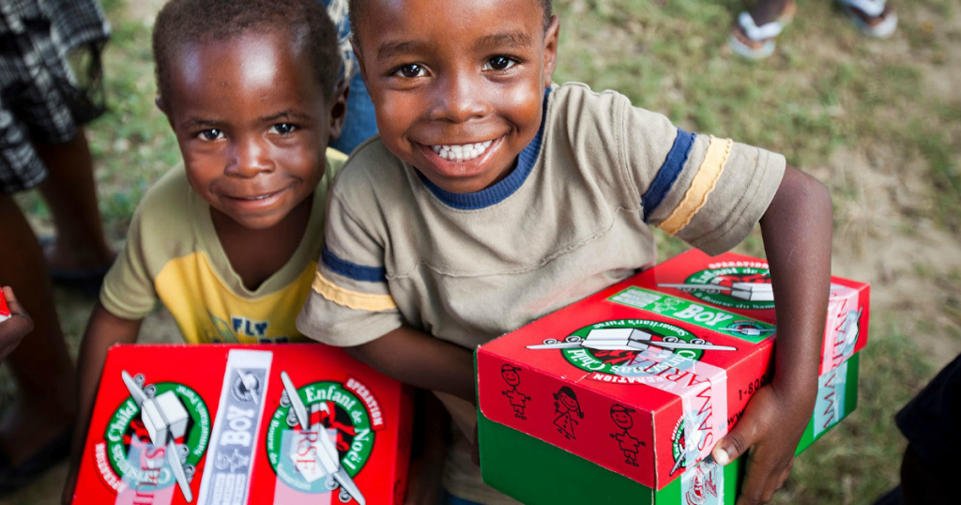
Fill Shoeboxes with your Fellowship Group and return to church by Fri, Nov. 14
请大家跟各团契一起装鞋盒礼物并于11 /14（周五）前带回教会。
WOW Gift 惊喜礼物
Toys 玩具
School Supplies
学校用品
Hygiene Items
卫生用品
Clothes
衣服

Slide 7
Please stay to enjoy our monthly luncheon today.

Slide 8
【2025 Scripture Recitation Final】
The Individual Challenge Final will be held at 1:15 pm today in the sanctuary, following the luncheon. Please passionately participate in the recitation and engrave God's word in your hearts!

Slide 9
Our 30th Anniversary Publication is ready. Please take ONE per family from the office. If you want a digital copy, please register at the office.

Slide 10
Thanksgiving (11/27) is approaching, and you are sincerely invited to share your 3~4-minute testimonies you have received from God over the past year. To help with preparation, please write down your testimony so it can be translated in advance. If you feel moved to share, please contact Brother Yiming Li: yimingli92@gmail.com, 913-952-1209.

Slide 11
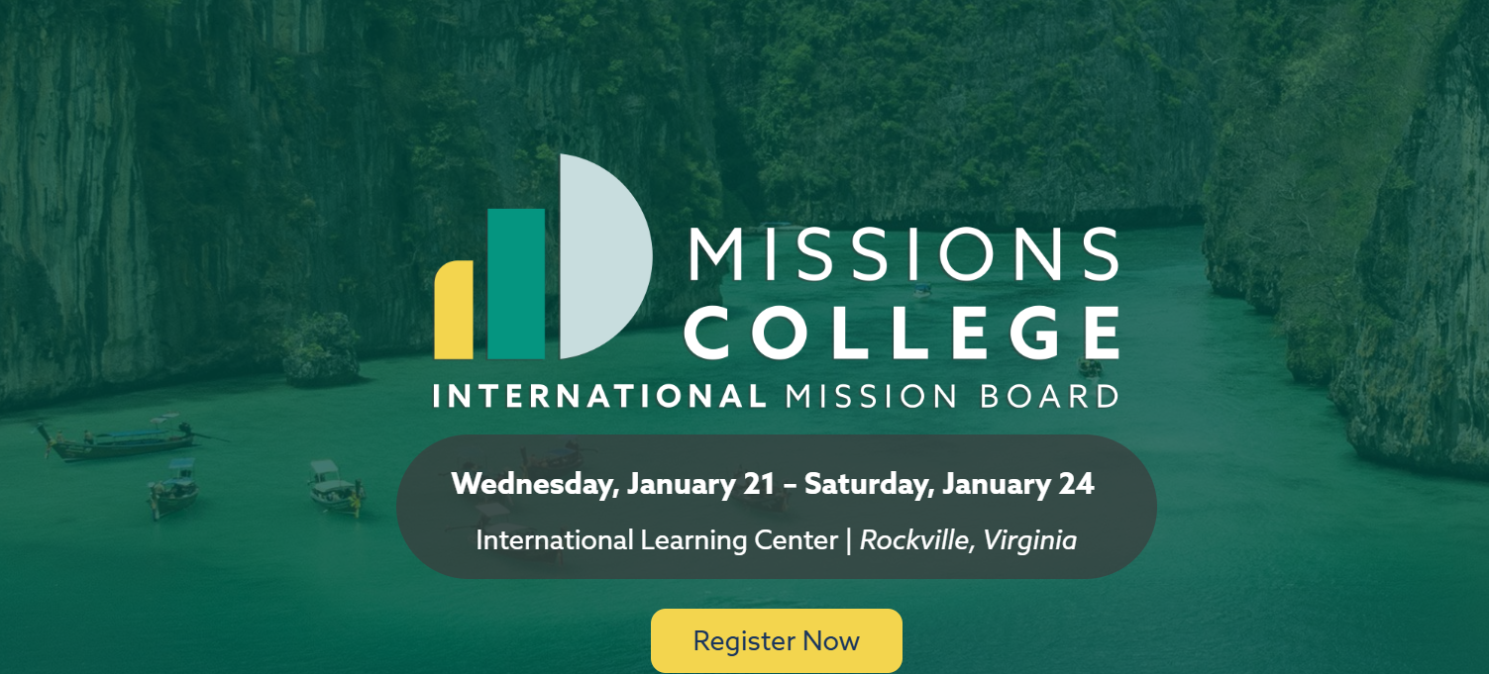
【2026 Missions College 】1/21~24 in Rockville, VA. Please register with Eric Li if you would like to go.

