Slide 1
ANNOUNCEMENTS

Slide 2
Thanksgiving Dinner, Baptism and sharing: 6-8:30pm. Please come with your families and friends to enjoy the holiday feast, witness the 7 baptisms and count the Lord’s blessings all together.

Slide 3
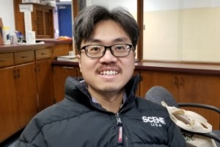
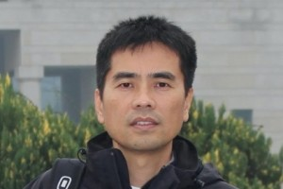
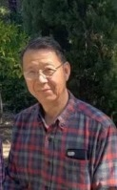
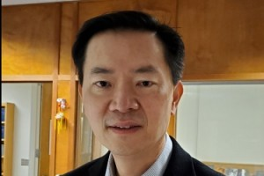
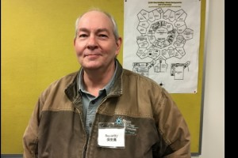
Elder-in-Training Candidates

Slide 4
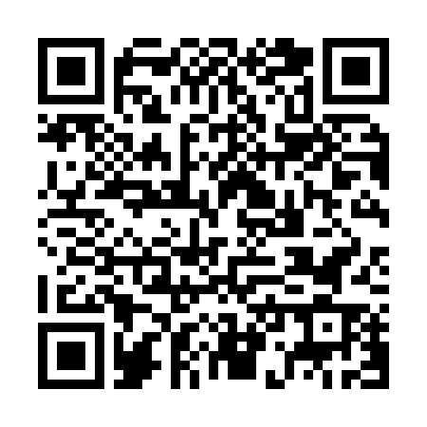
Candidate Q&A Sessions
11/23/2025 (Sun)
David Cage 凯·大卫 | Mike Cheung 张学辉
2 PM – 4 PM | Worship Hall
11/30/2025 (Sun)
Yiming Li 郦一明 | Jonathon Lee 李寿富
2 PM – 4 PM | Worship Hall
12/7/2025 (Sun)
Philip Ruan 阮英昶
2 PM – 4 PM | Worship Hall
Scan QR Code for digital access →

Slide 5
2025 Elder-in-Training Candidates Announcement
The Elder-in-Training Candidates were nominated by the pastoral team and will be interviewed by church members.
On December 28, 2025, members will vote to approve the candidates (75% approval required). Approved candidates will work alongside pastors for one year before being confirmed as elders.
Full questionnaire responses are posted on the hallway board.
Printed copies are available in the church office.
Digital copy available here:
https://drive.google.com/file/d/1v1jCPQ-pGshWbYg1TFzHPr0u53JTJ1Y3/view?usp=sharing

Slide 6
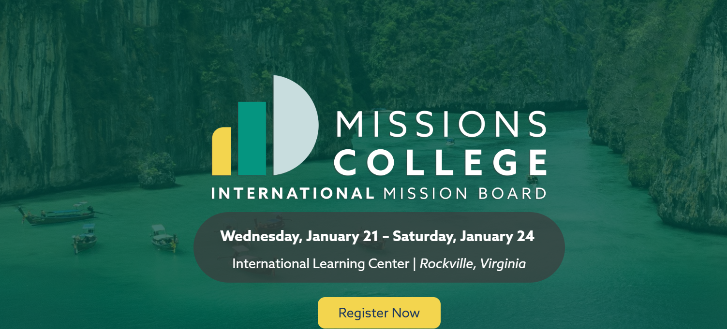
【2026 Missions College 】1/21~24 in Rockville, VA. Please register with Eric Li if you would like to go.

