Slide 1

【Announcements】

Slide 2


Slide 3
Please stay to attend the monthly prayer meeting after Sunday school today 12:30-1:00 pm.

Slide 4
Harvest Night
* Registration for children ages 4 - 11 and their families for this event ends today. Please register ASAP if interested.
* All volunteers, please attend the informational meeting in room 123 at 12:30-12:45p today.

Slide 5
【2025 Scripture Recitation Finals】 【Fellowship Final】 shall be done with their favorite time and form of recitation, and report the number of participants and the total number of verses recited to Sister Wenqing An by 11/2. 【Individual Final】will be held at 1:15 pm on 11/9 in the sanctuary, following the luncheon. The challenger will be reminded of the sentence before the first punctuation mark! Please passionately participate in the recitation and engrave God's word in your hearts!

Slide 6

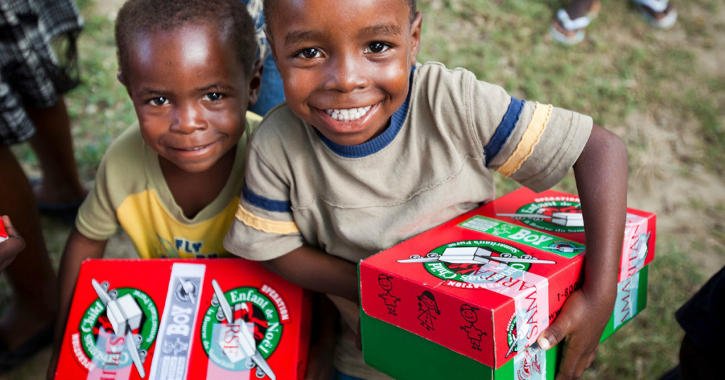
Fill Shoeboxes with your Fellowship Group and return to church by Fri, Nov. 14 请大家跟各团契一起装鞋盒礼物并于11 /14（周五）前带回教会。
WOW Gift 惊喜礼物
Toys 玩具
School Supplies
学校用品
Hygiene Items
卫生用品
Clothes
衣服

Slide 7
Hello! As you can see, it’s time to start packing shoeboxes for Operation Christmas Child. We love this event because it is cross-congregational and inter-generational, so it is a project that unifies our entire church body. Not only are the children who receive your shoeboxes blessed, but when we see the results of our church working together, we bless each other. Last year we sent 277 shoeboxes that went to Mexico, Guatemala in Central America, and the Democratic Republic of the Congo in Africa. This year our goal is to fill 300 shoeboxes! Each fellowship group will receive 12 boxes so please send a representative to pick up your bag. The due date to return completed shoeboxes is Friday, November 14. First, choose who you are going to fill your box for by selecting a boy or girl and

Slide 8
their age category and place the identifying sticker on the front of the box. Fill your box with a special WOW gift to immediately attract their attention when they open it. Then continue filling it with other smaller toys, school supplies, hygiene items, and clothes. This year, Samaritan’s Purse is instructing NOT to include bars of soap. There are other items that should NOT be included such as food, chocolate, medicines, vitamins, toothpaste, glass or porcelain, or war-related toys like water guns or army men because these boxes can go to war torn countries. Personal notes are very special for the children so please take time to include them. One very poor mother in Africa with 2 sons said she is always looking through trash for a pencil and when she finds one, she will break it in half for her 2 sons.

Slide 9
Then one day her sons received an Operation Christmas Child shoebox, and they found brand-new whole pencils in it! They were all so happy and believed that God really blessed them because they can go to school and learn. The simplest things that we take for granted are greatly appreciated by these children who have never received a gift in their life. It costs $10 per box for shipping, and the church will cover that expense. If you cannot fill a shoebox but would like to financially contribute to this ministry, you may write a check to ECBC and designate “Shoebox Gift” in the memo. Part of the $10 per box also goes towards discipleship materials in the child’s language. Each child who receives a shoebox gets to hear the Gospel and is plugged into a local church. Many times, not only

Slide 10
does the child hear the Gospel and become a Christian but their extended families are brought to church because the child first received their shoebox gift. The greatest gift is the gift of Jesus! Thank you very much for supporting Operation Christmas Child!

